Slide 1
name : SRINIVAS HEMANT PATEL
Course NAME : Professional Program in Data Analytics with Gen AI - 71 mentor name : ASHISH RAJPUT
Analyze OTT Platform Viewing Patterns

Slide 2
Introduction
OTT platforms have changed the way people watch movies, TV shows, and web series.
Understanding user viewing behaviour helps improve content recommendations and customer satisfaction.
Analyzing subscriptions and user engagement supports better business planning.
This project examines viewing patterns, content performance, and customer feedback.
The insights help OTT platforms enhance user experience and make informed business decisions.

Slide 3
DATASET SOURCE
Dataset Source : NIIT Portal
Totals No. of Datasets = 5
Sr. No. | Dataset Name | No. of Rows | Dataset Link
1 | User_Profile.xlsx | 500 | Open Link
2 | Viewing_Activity.xlsx | 10,000 | Open Link
3 | Subscription_Retention.xlsx | 500 | Open Link
4 | Ratings_Feedback.xlsx | 10,000 | Open Link
5 | Content_Library.xlsx | 200 | Open Link

Slide 4

OBJECTIVES & TASKS
Sr. No. | Objective | Tasks | Tools
1 | Identify Popular Content | Content Preference Analysis, Platform Comparison, Content Performance | Excel
2 | Understand Viewing Behaviour | Audience Analysis, Device & Region Analysis, Peak Viewing Time | SQL
3 | Evaluate User Engagement | Subscription Comparison, Engagement Analysis, Renewal & Churn Analysis | Python
4 | Evaluate User Feedback | Ratings Analysis, Completion Behaviour, Viewing Pattern Analysis | EDA (Python)
5 | Present Business Insights | Interactive Dashboard, KPIs, Data Filtering | Power BI
6 | Support Business Decisions | Retention Prediction, Churn Prediction, Model Evaluation | Machine Learning

Slide 5
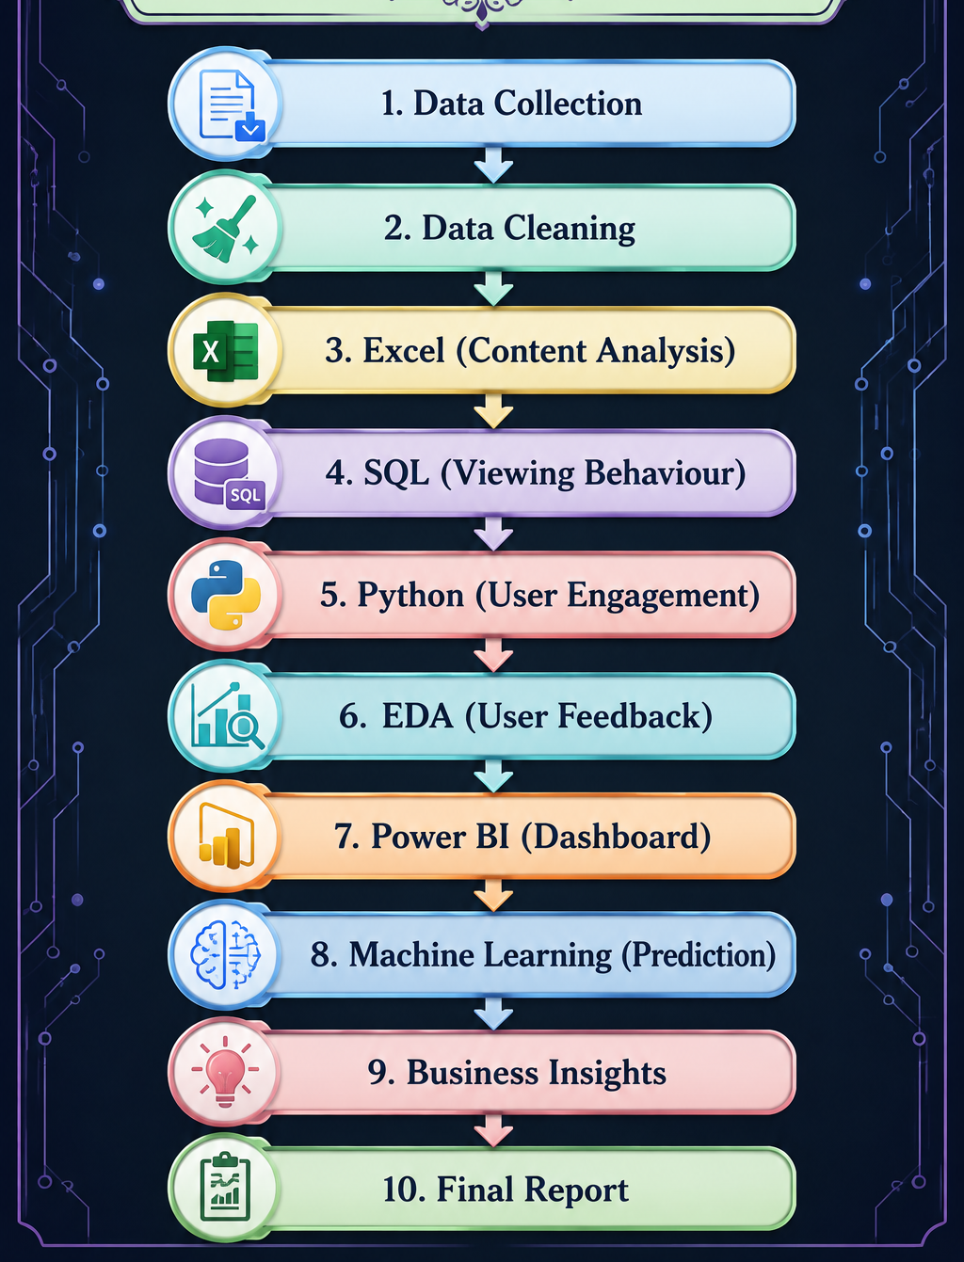
PROJECT FLOW

Slide 6
Objective 1 :- Identify Popular Content

Slide 7
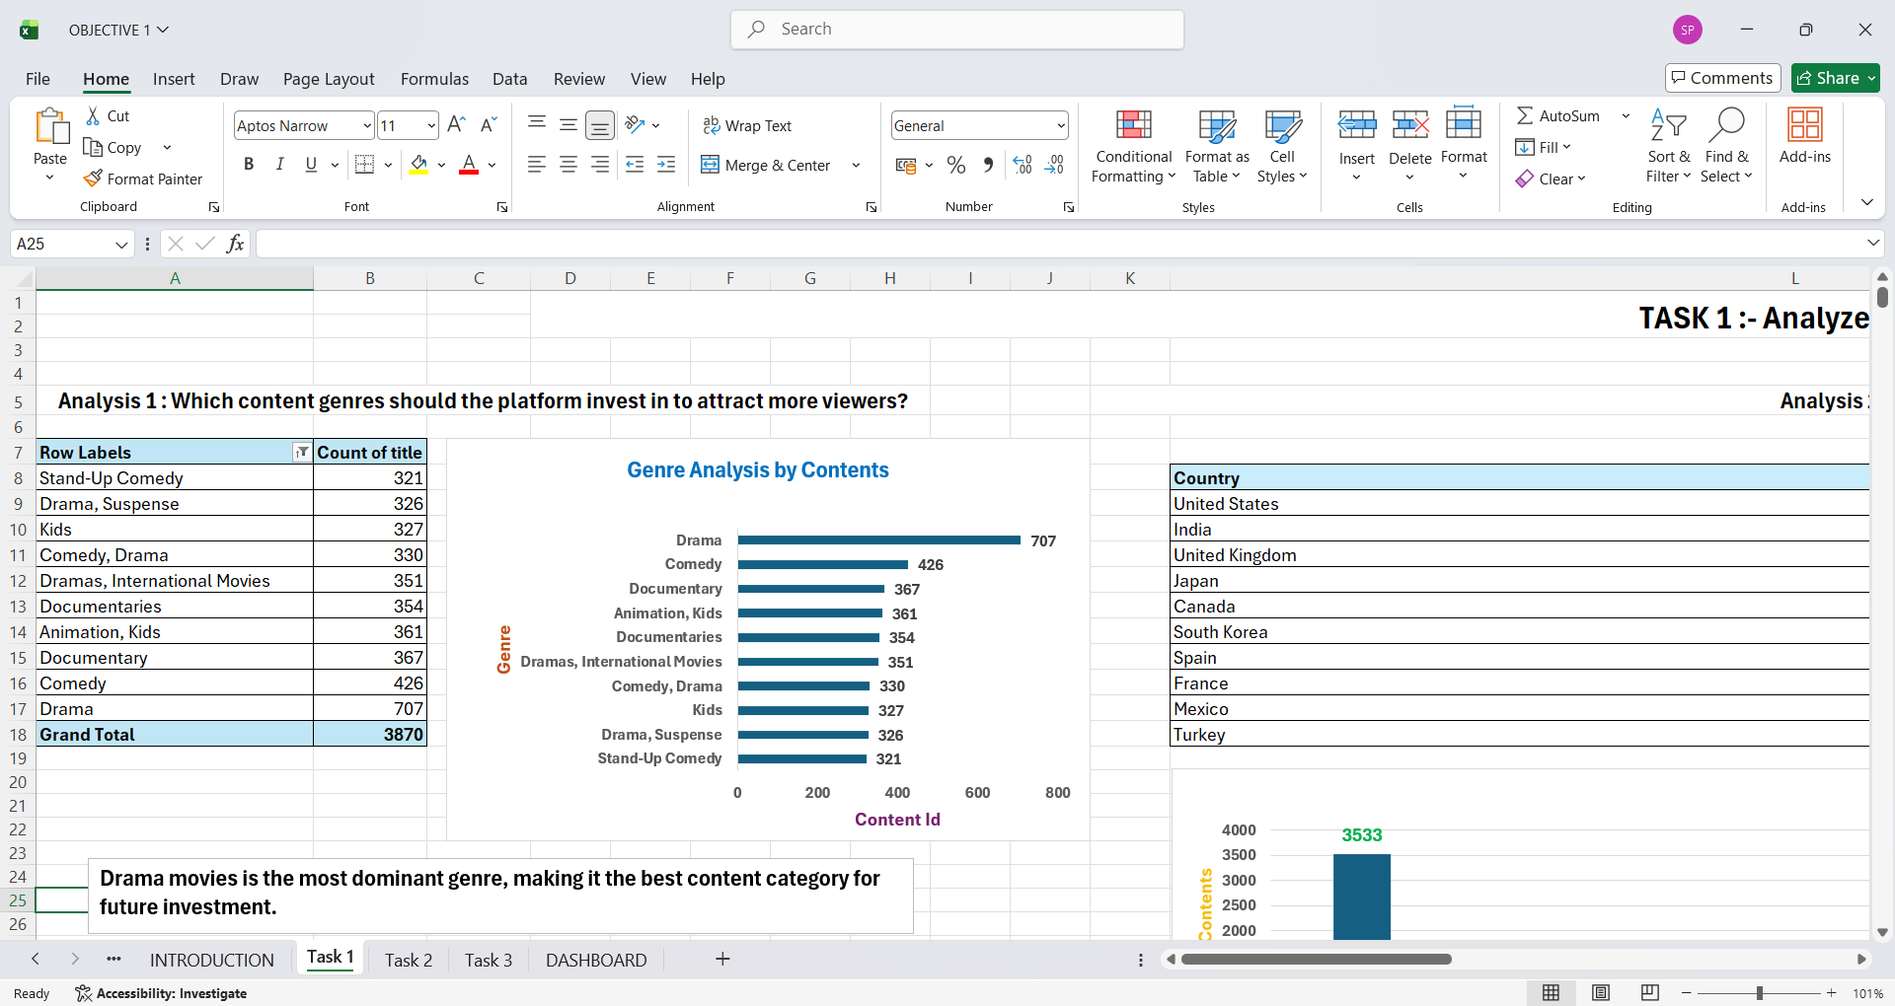
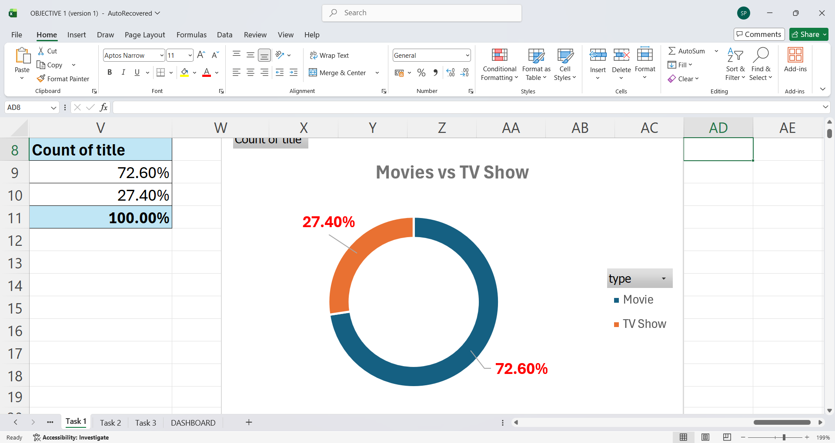
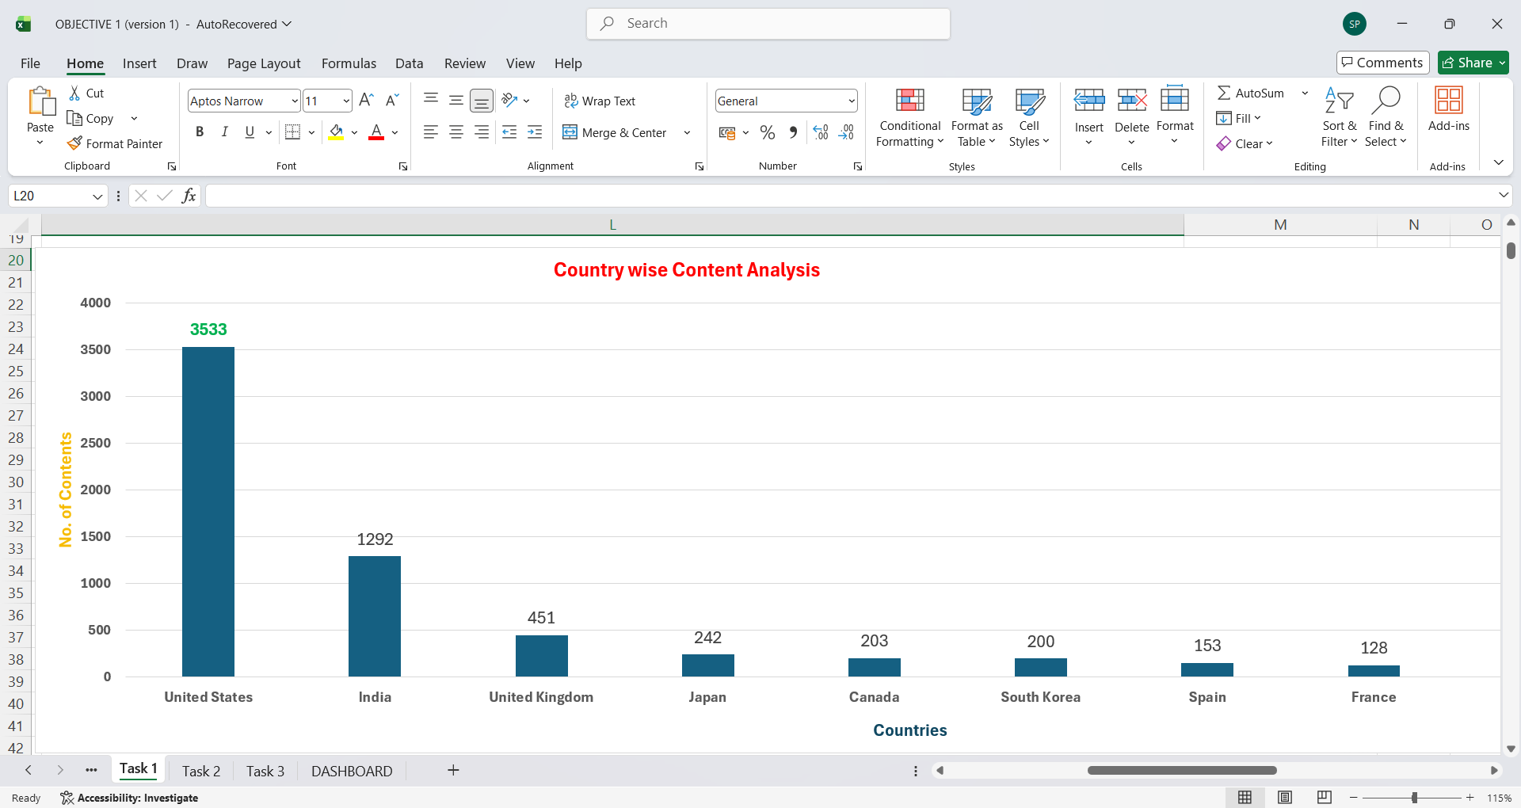
TASK 1 :- Analyze Content Preferences
Q. Which genres should the platform invest in to attract more viewers?
Q. Should the OTT focus more on Movies or TV Shows to meet customer demand?
Q. Which countries contribute the highest amount of content in OTT?
Interpretation :- Drama movies is the most dominant genre, making it the best content category for future investment.
Interpretation : The platform should focus more on Movies , along with increasing investments in TV Shows
Interpretation : The United States contributes the highest amount of OTT content (Movies + TV Shows), followed by India.

Slide 8

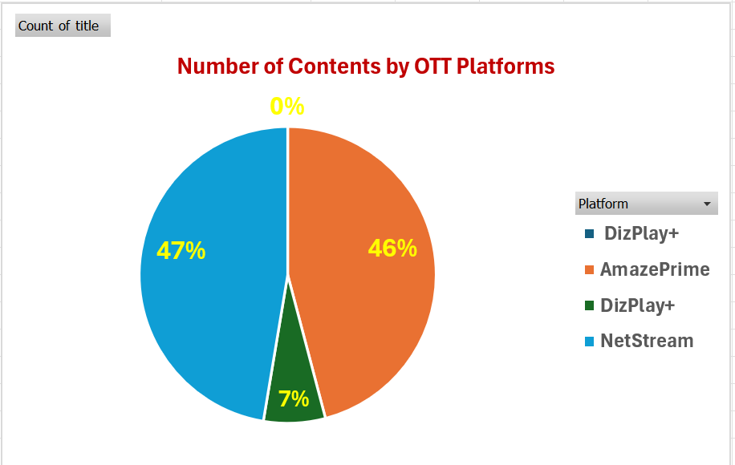
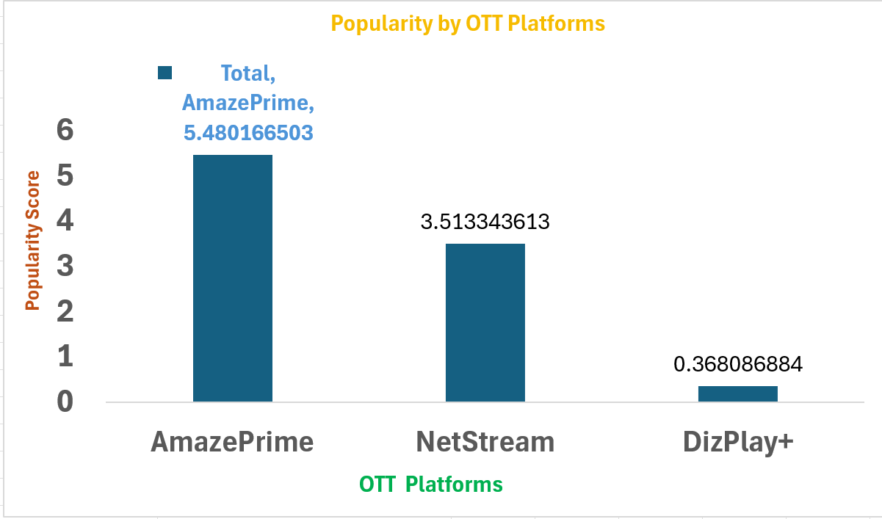
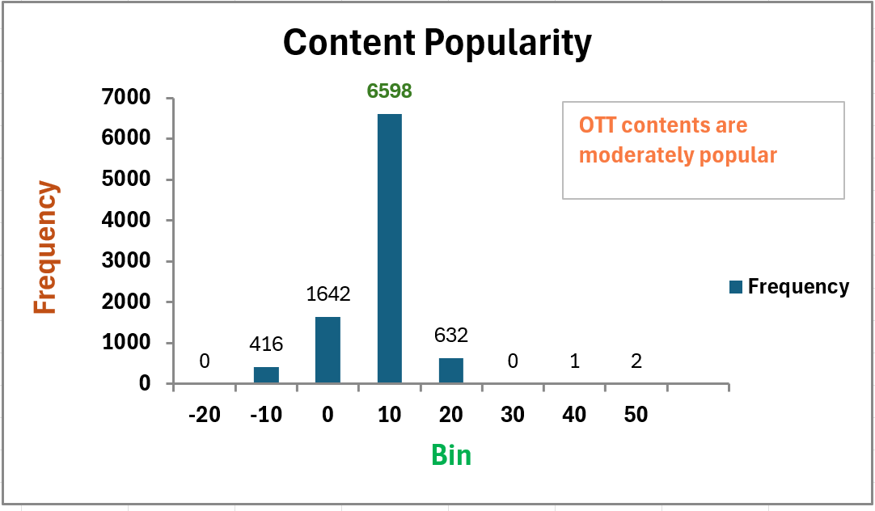
TASK 2 : Evaluate OTT Platform Performance
Q. Which OTT platform has the largest content library?
Q. Which OTT platform is most popular among users?
Q. Is most of the OTT content highly popular, moderately popular, or low performing?
Interpretation : NetStream offers the widest variety of content for viewers.
Interpretation : Amaze Prime is most preferred OTT platform among users
Interpretation :- Most of the OTT platform's content is moderately popular (in range 0 to 10), indicating balanced mix of content among viewers .

Slide 9
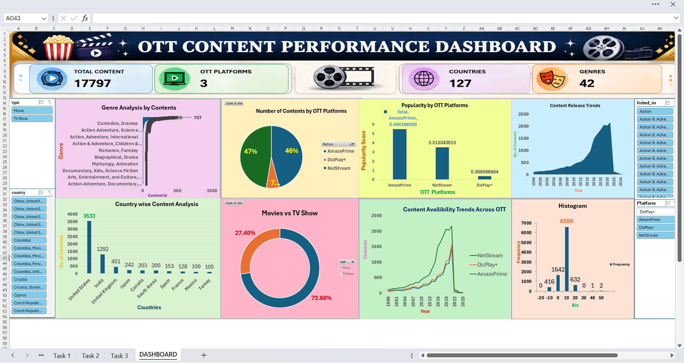
DASHBOARD

Slide 10
Objective 2 :- Understand Viewing Behaviour

Slide 11
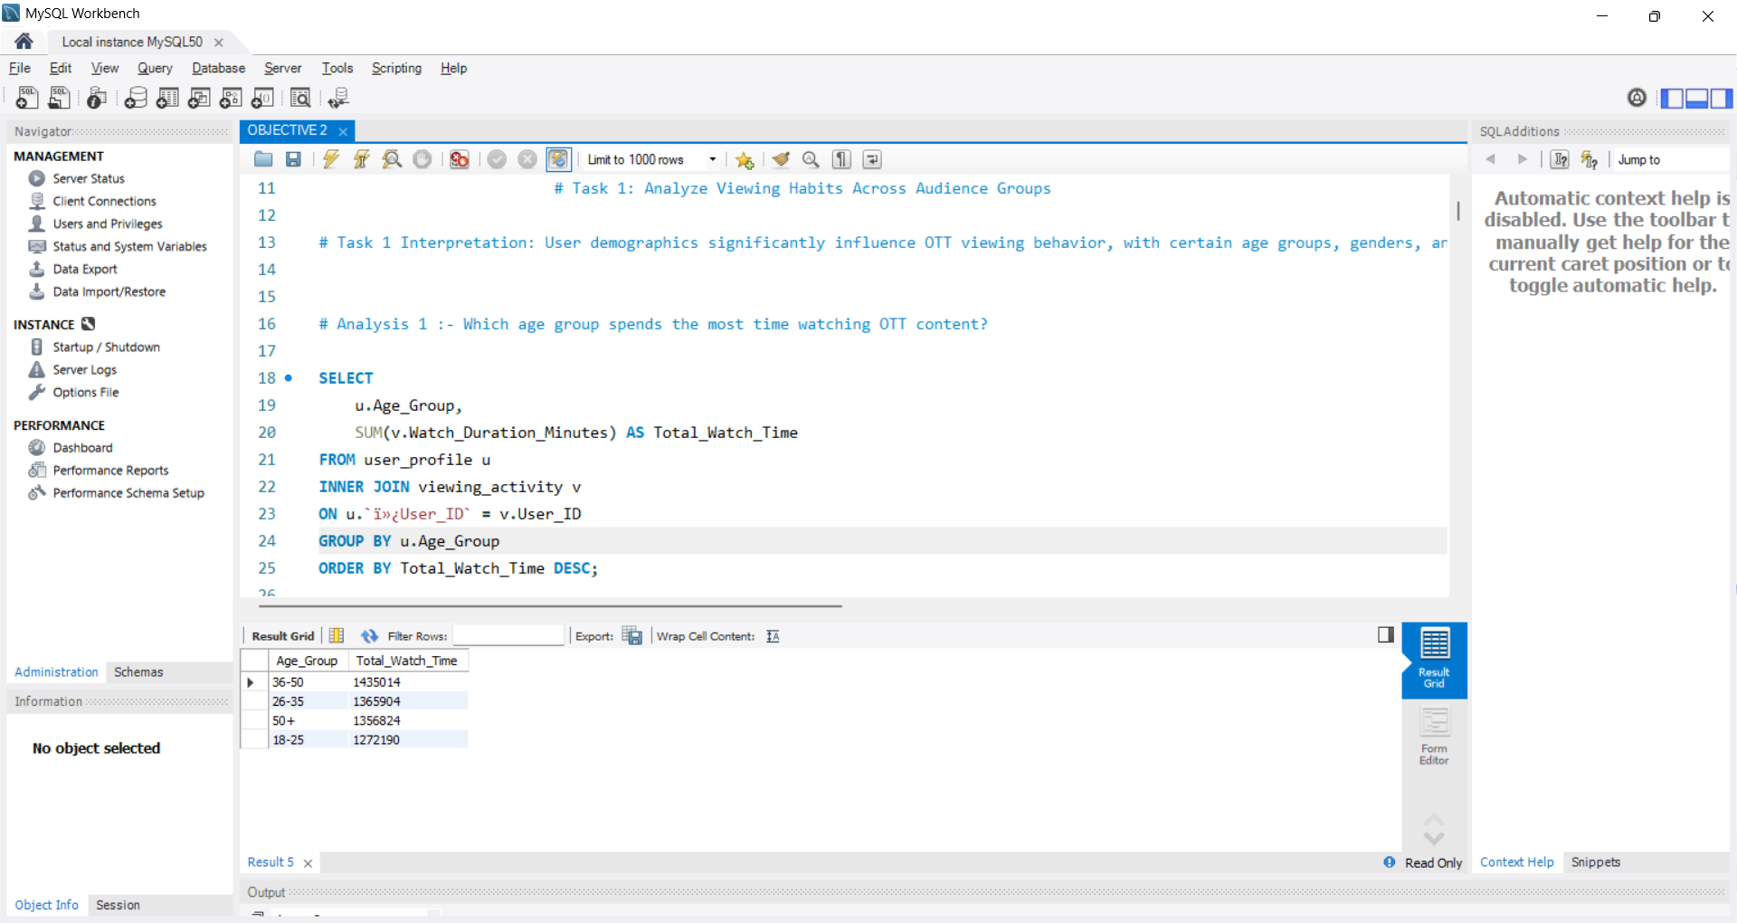
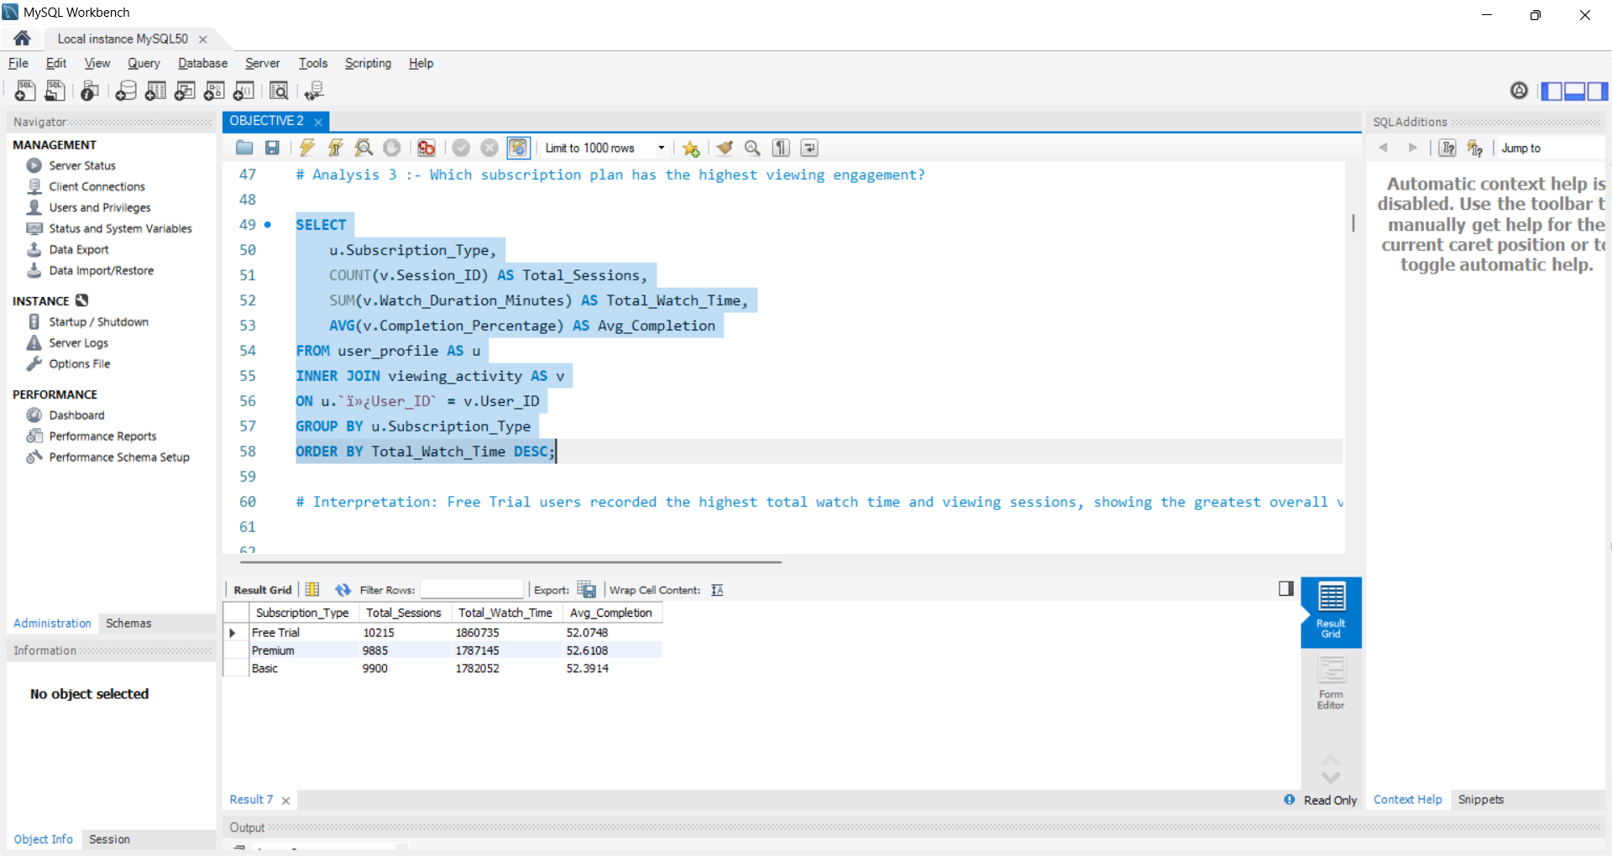
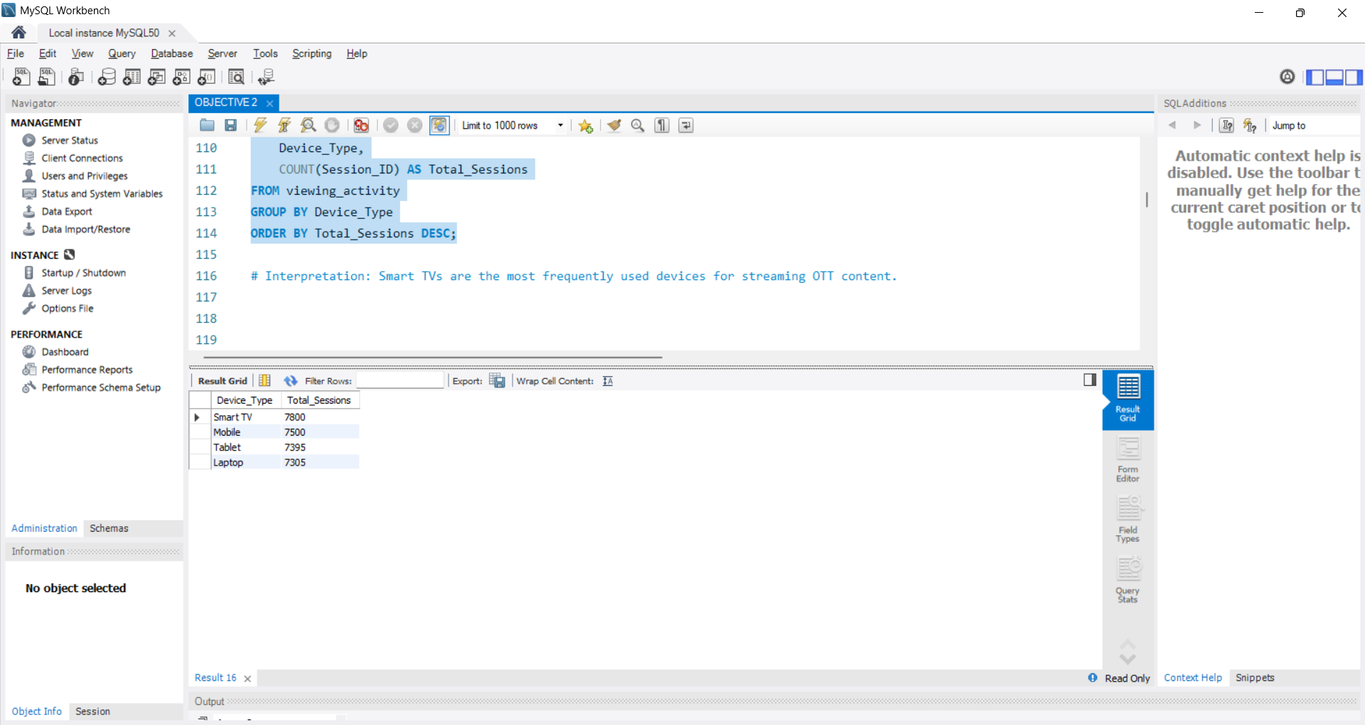
Task 1: Analyze Viewing Habits Across Audience Groups
Q. Which age group spends the most time watching OTT content?
Q. Which subscription plan has the highest viewing engagement?
Q. Which device is most frequently used for streaming OTT content?
Interpretation :- 36-50 Age Group spends most time watching OTT content
Interpretation : Free Trial users recorded the highest total watch time and viewing sessions
Interpretation : Smart TVs are the most frequently used devices for streaming OTT content.

Slide 12
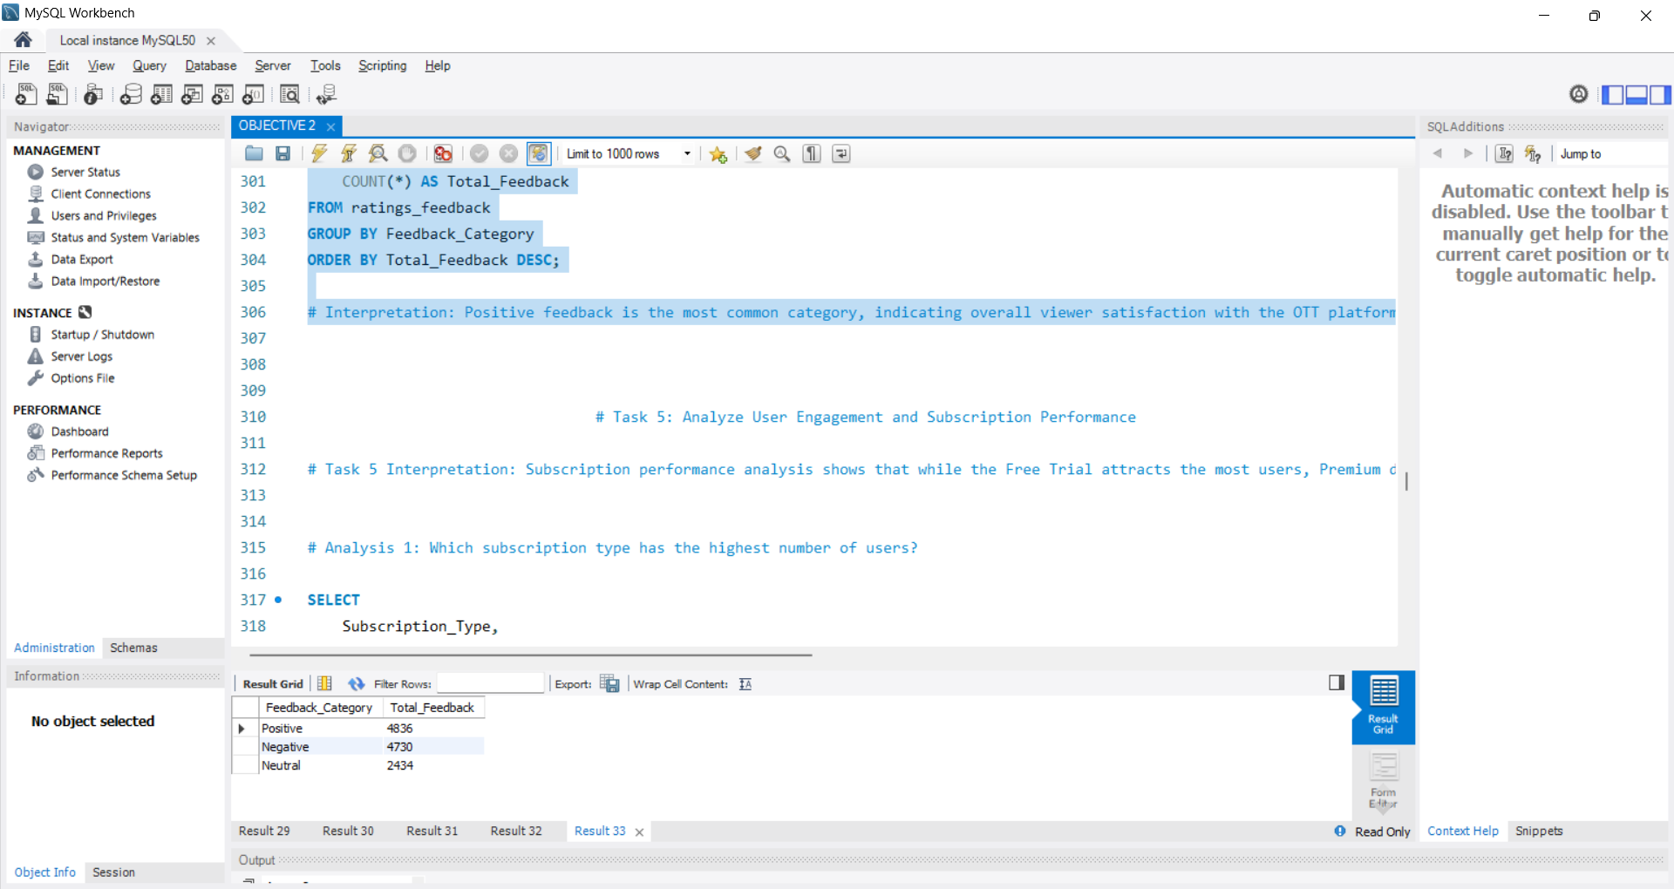
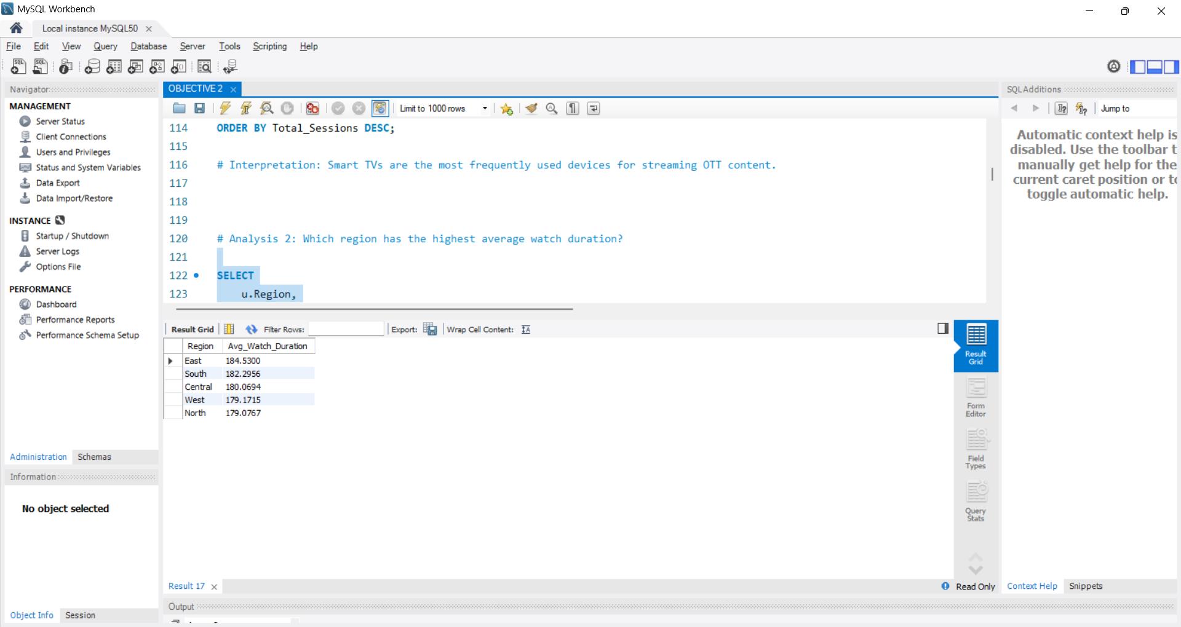
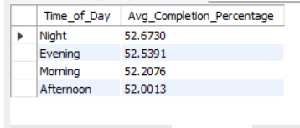
Task 2: Identify Peak Viewing Time Trends & FEEDBACK CATEGORY
Q. What is the distribution of feedback categories?
Q. Which region has the highest average watch duration?
Q. Which time of day has the highest average content completion percentage?
Interpretation : Positive is the most feedback common category, indicating overall viewer satisfaction with the OTT platform.
Interpretation : The East region has the highest average watch duration, indicating the strongest viewer engagement.
Interpretation : Users have the highest average content completion percentage in night , showing the strongest viewing engagement

Slide 13
Objective 3 :- Evaluate User Engagement

Slide 14
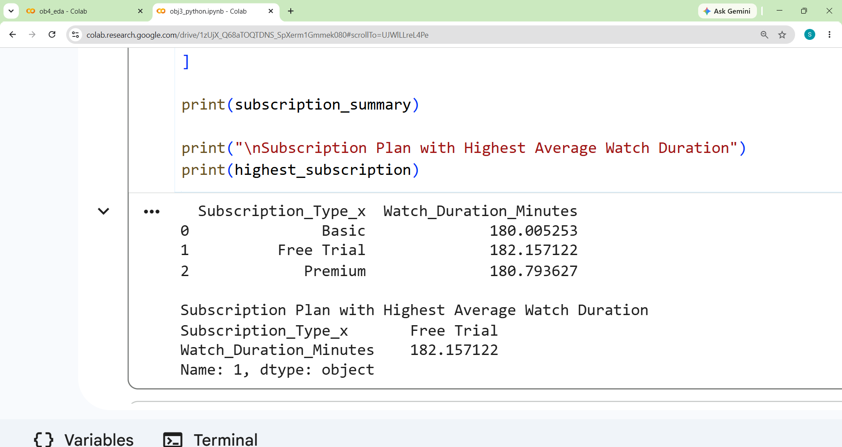
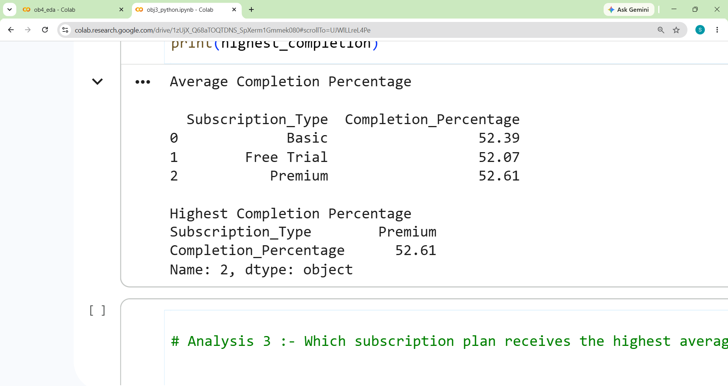
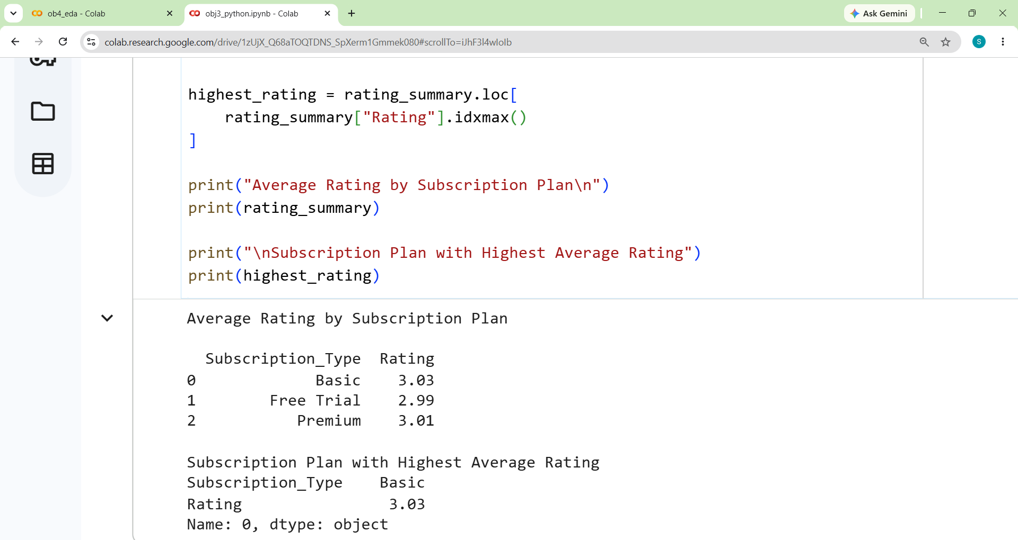
TASK 1 : Analyze User Engagement Across Different Segments
Q. Which subscription plan has the highest average watch duration?
Q. Which subscription plan has the highest average content completion percentage?
Q. Which subscription plan receives the highest average user rating?
Interpretation :- Free Trial users have the highest average watch duration of approximately 182.16 minutes.
Interpretation :- Premium users have the highest average completion percentage of approximately 52.61%.
Interpretation :- Basic users provide the highest average rating of approximately 3.03.

Slide 15
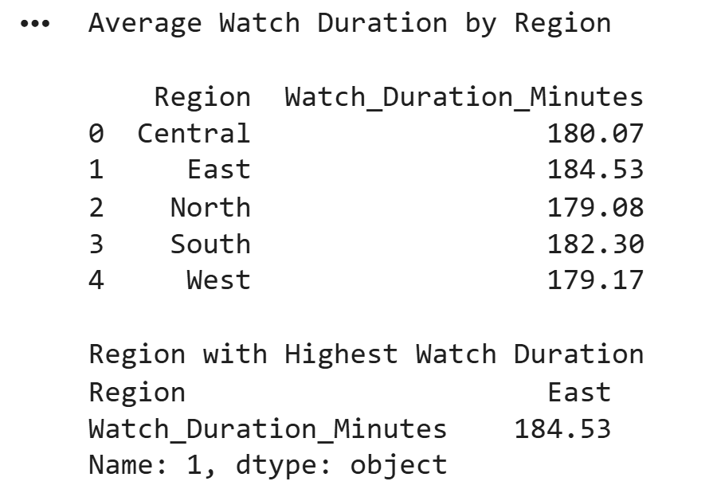
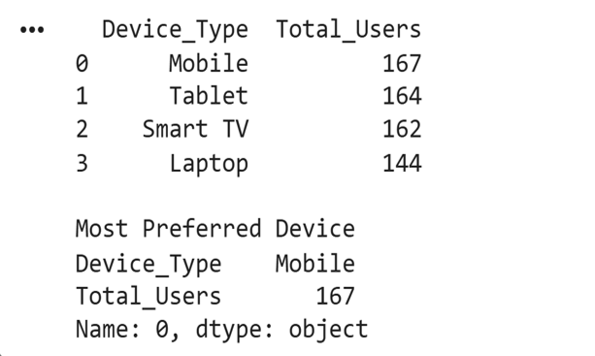
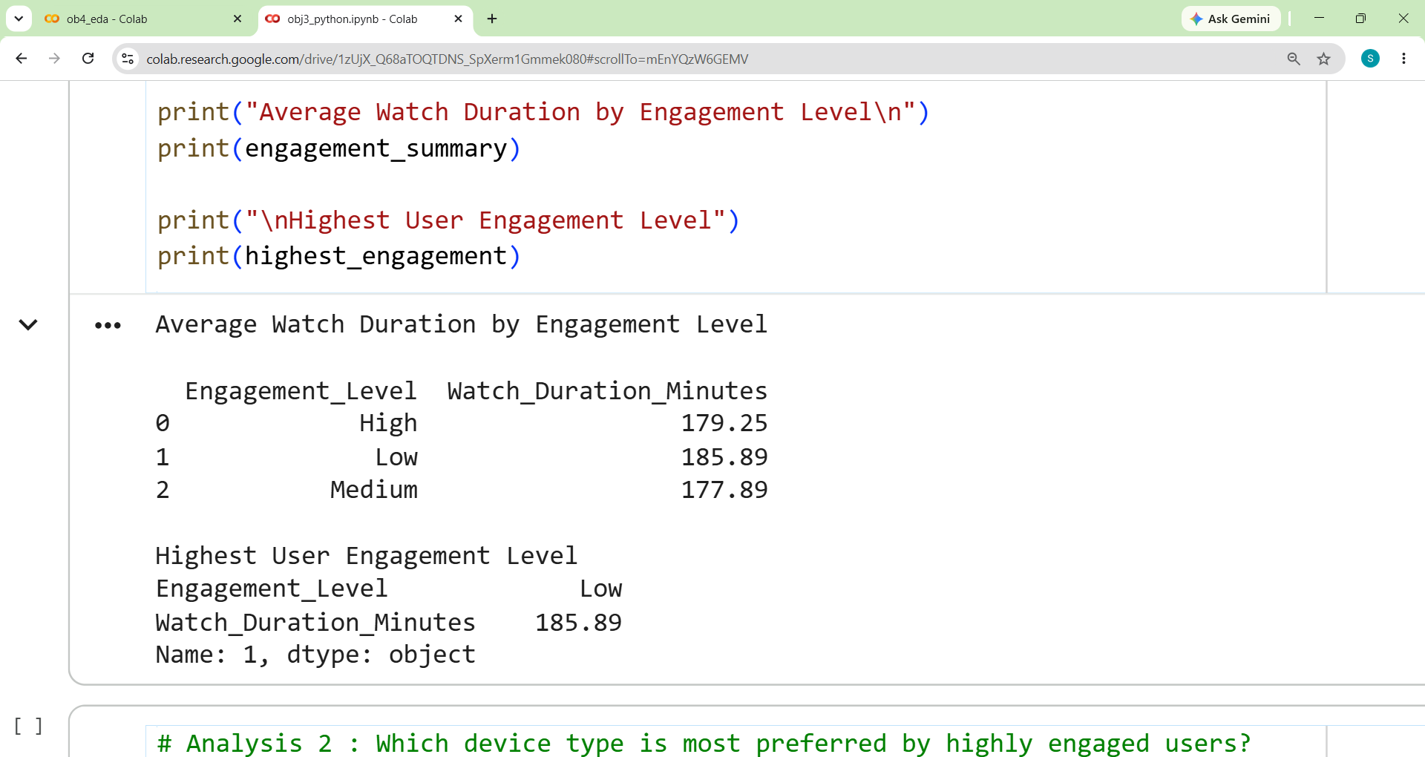
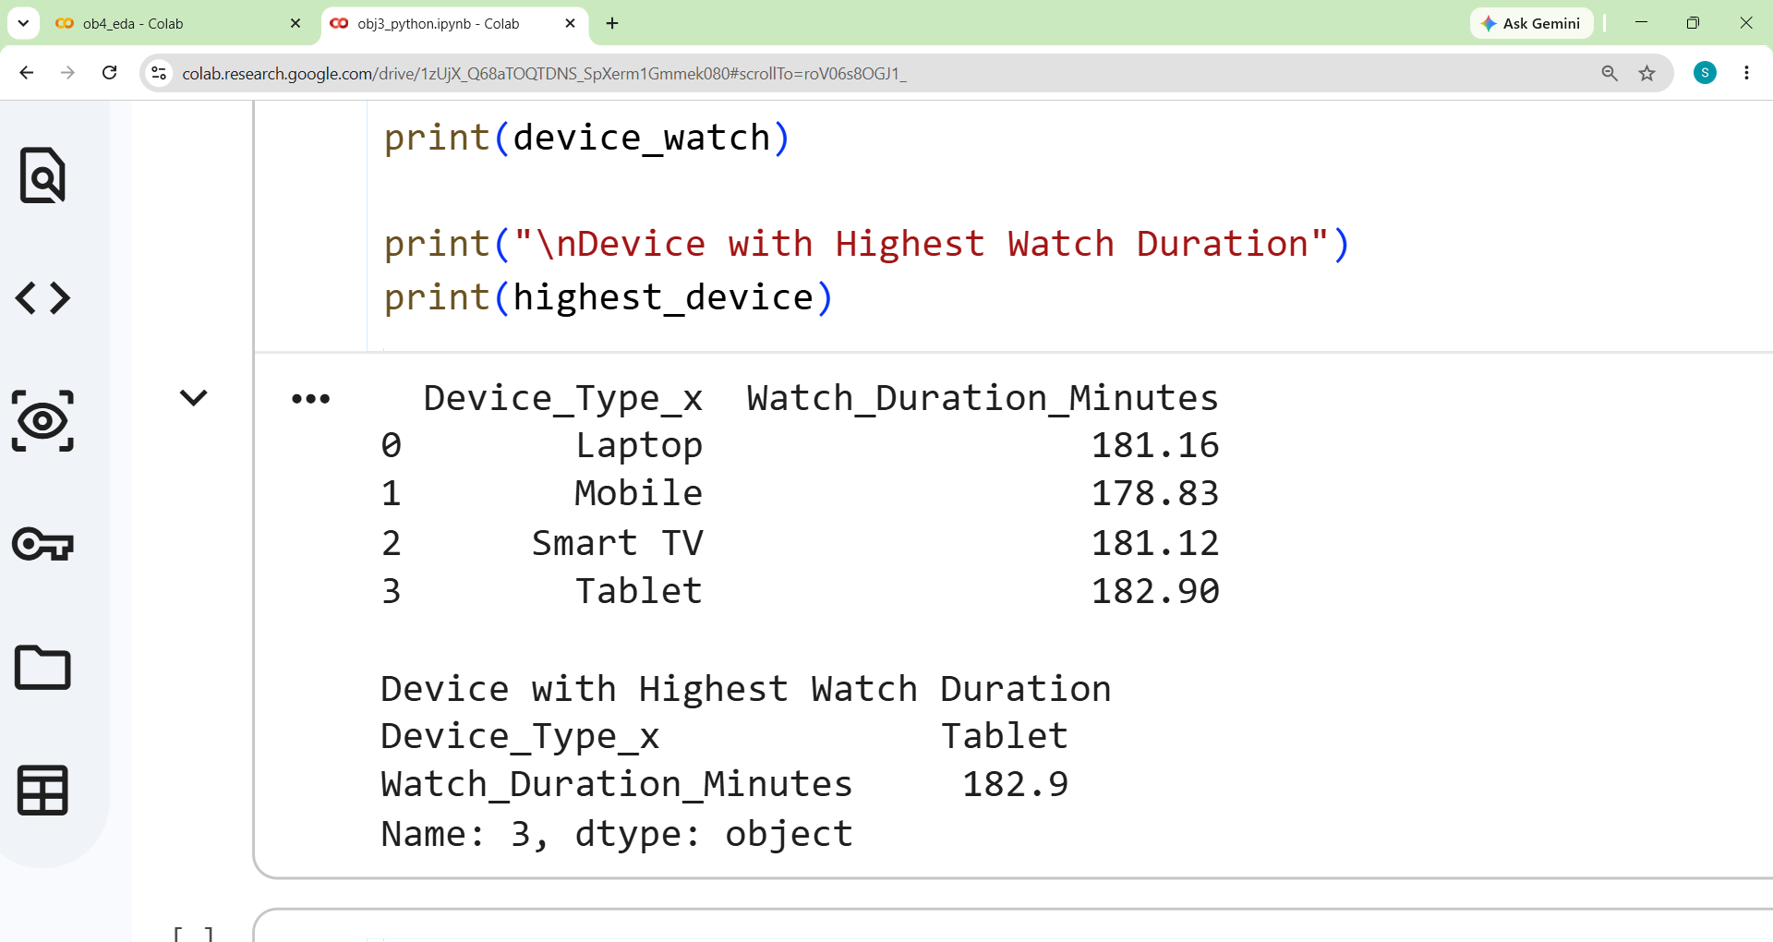
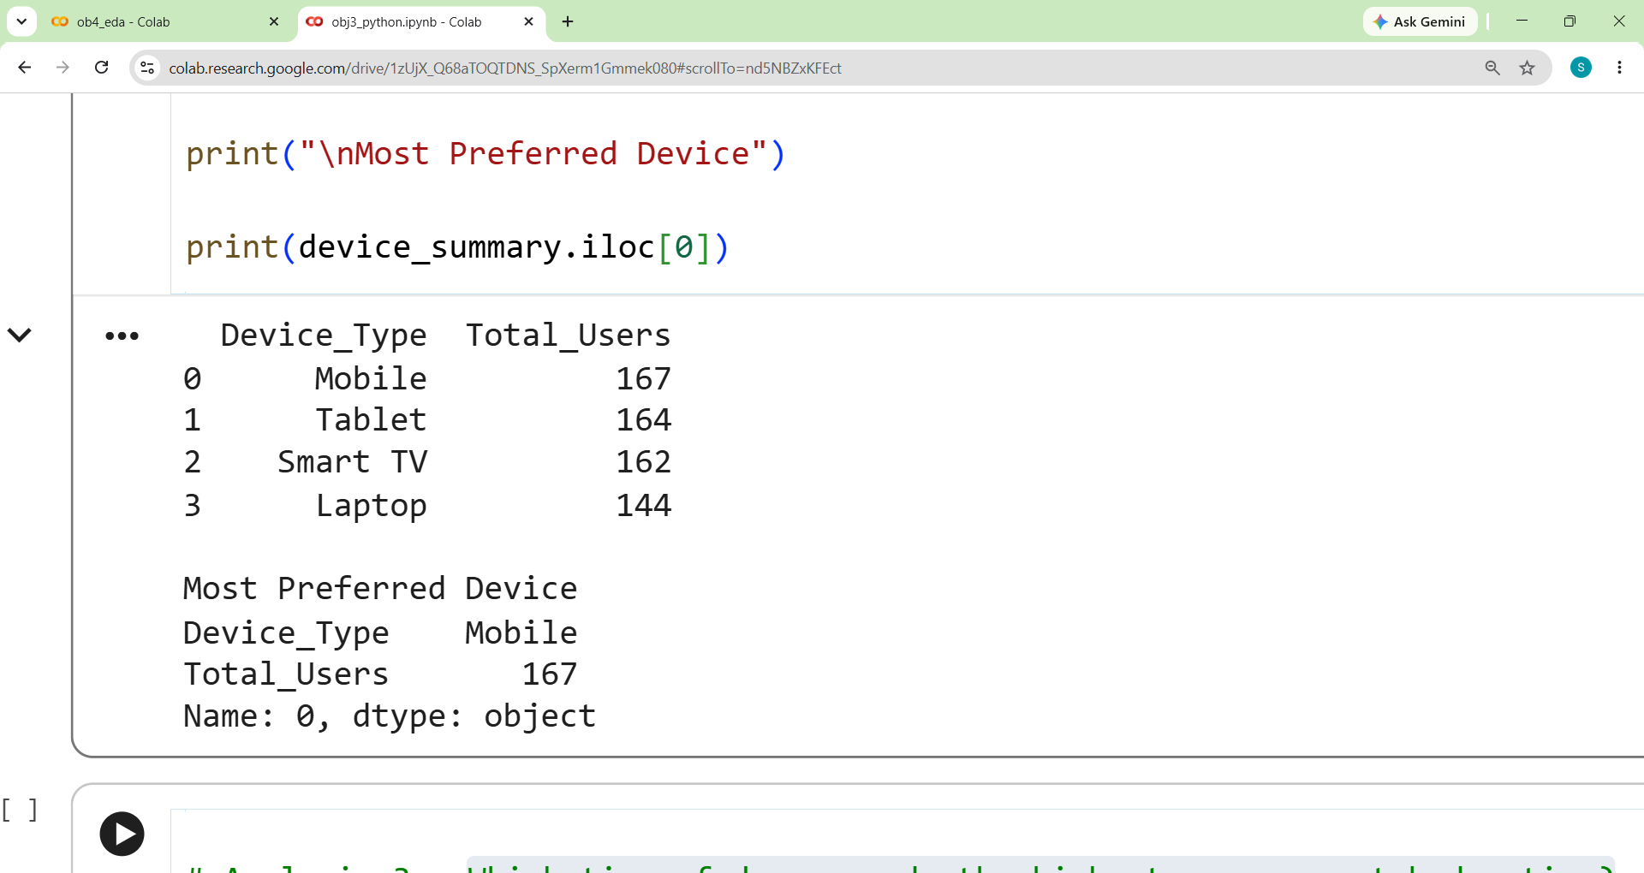
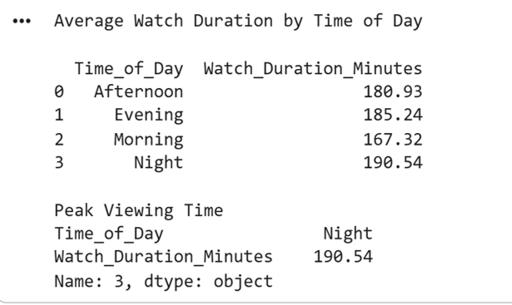
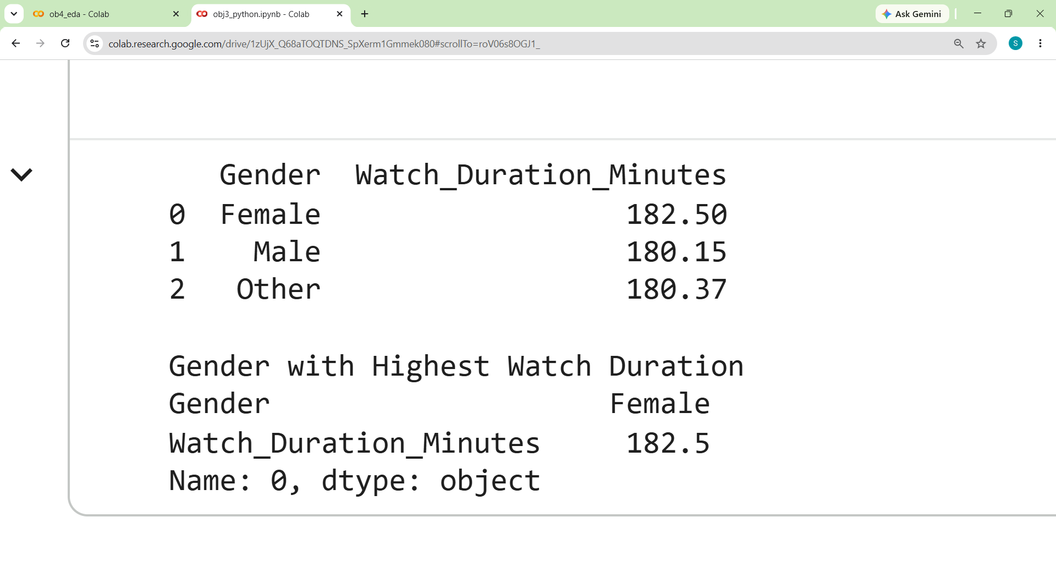
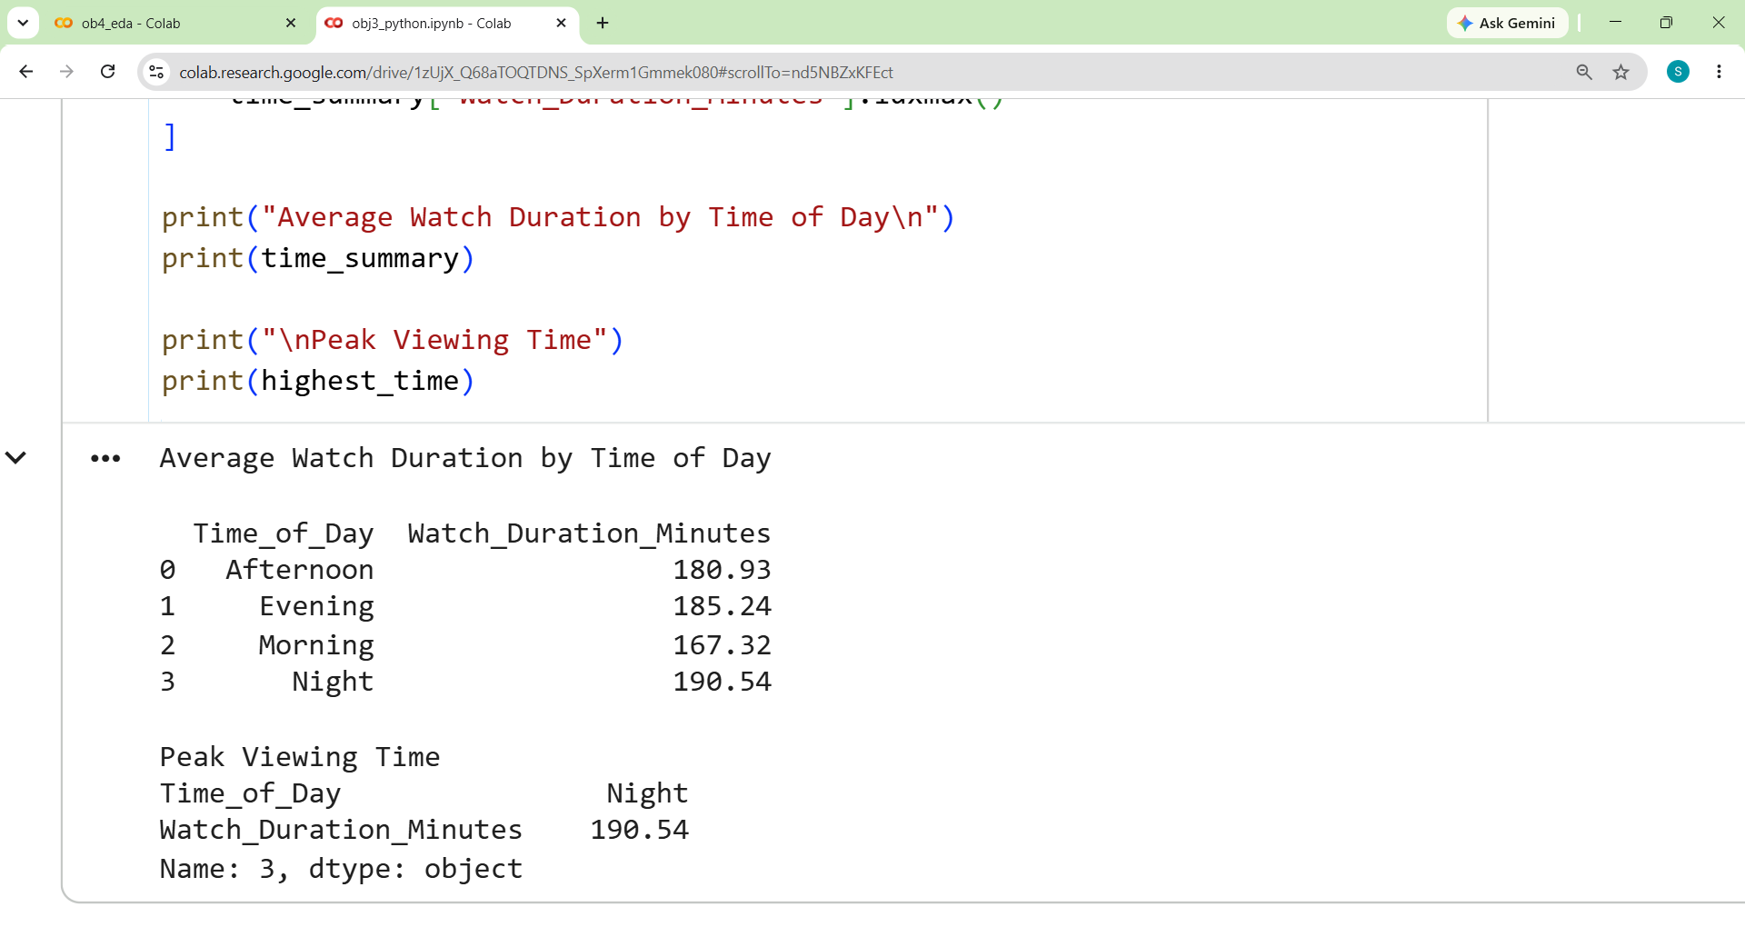
Task 2 :- analyze User Viewing Behaviour
Q. Which user engagement level records the highest average watch duration?
Q. Which device type is most preferred by highly engaged users?
Q. Which time of day records the highest average watch duration?
Interpretation :- East region records the highest average watch duration of approximately 184.53 minutes.
Interpretation :- Mobile is the most preferred device with approximately 167 users.
Interpretation :- Female users record the highest average watch duration of approximately 182.50 minutes.

Slide 16
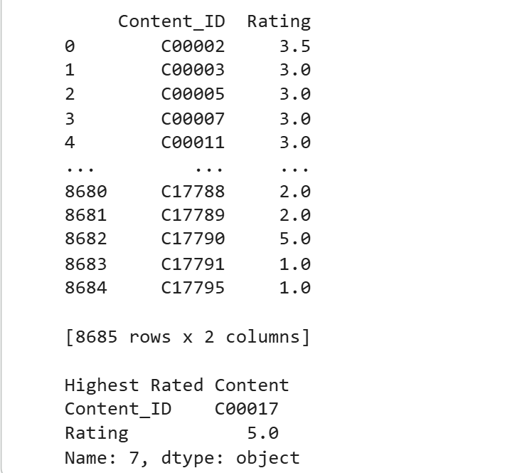
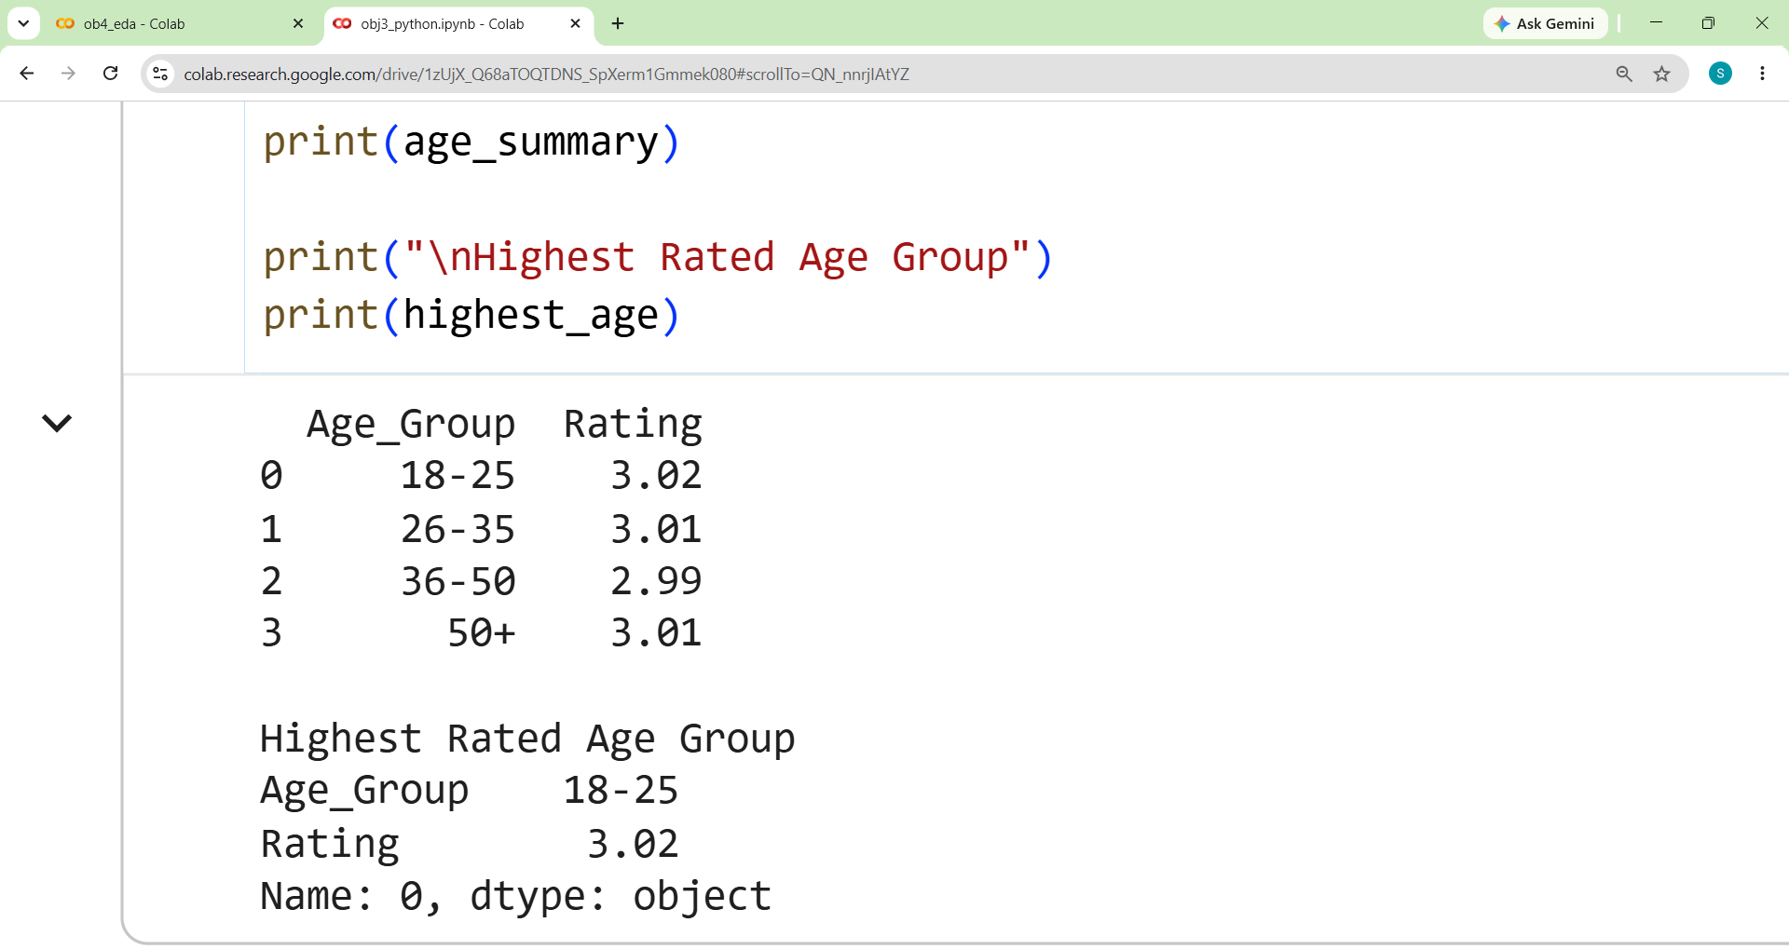
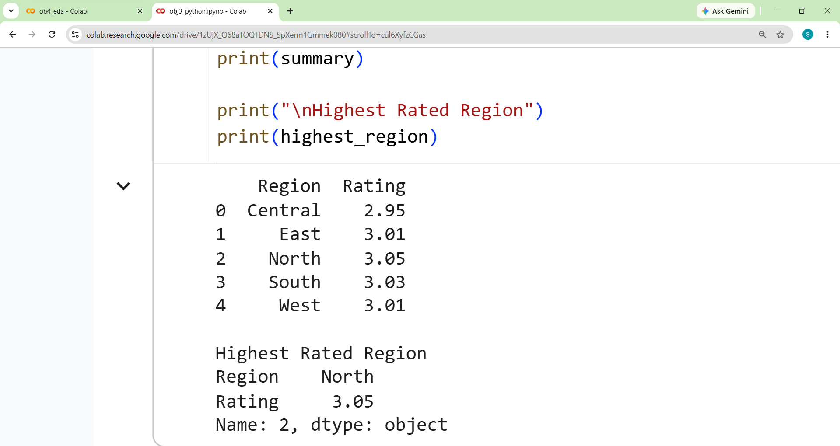
Task 4 :- Analyze User Ratings and Preferences
Q. Which content receives the highest average rating?
Q. Which age group provides the highest rating?
Q. Which region provides the highest ratings?
Interpretation :- Content ID C00017 receives the highest average rating of 5.0.
Interpretation :- The 18–25 age group provides the highest average rating of approximately 3.02.
Interpretation :- The North region provides the highest average rating of approximately 3.05.

Slide 17
Objective 4 :- Evaluate User Engagement

Slide 18
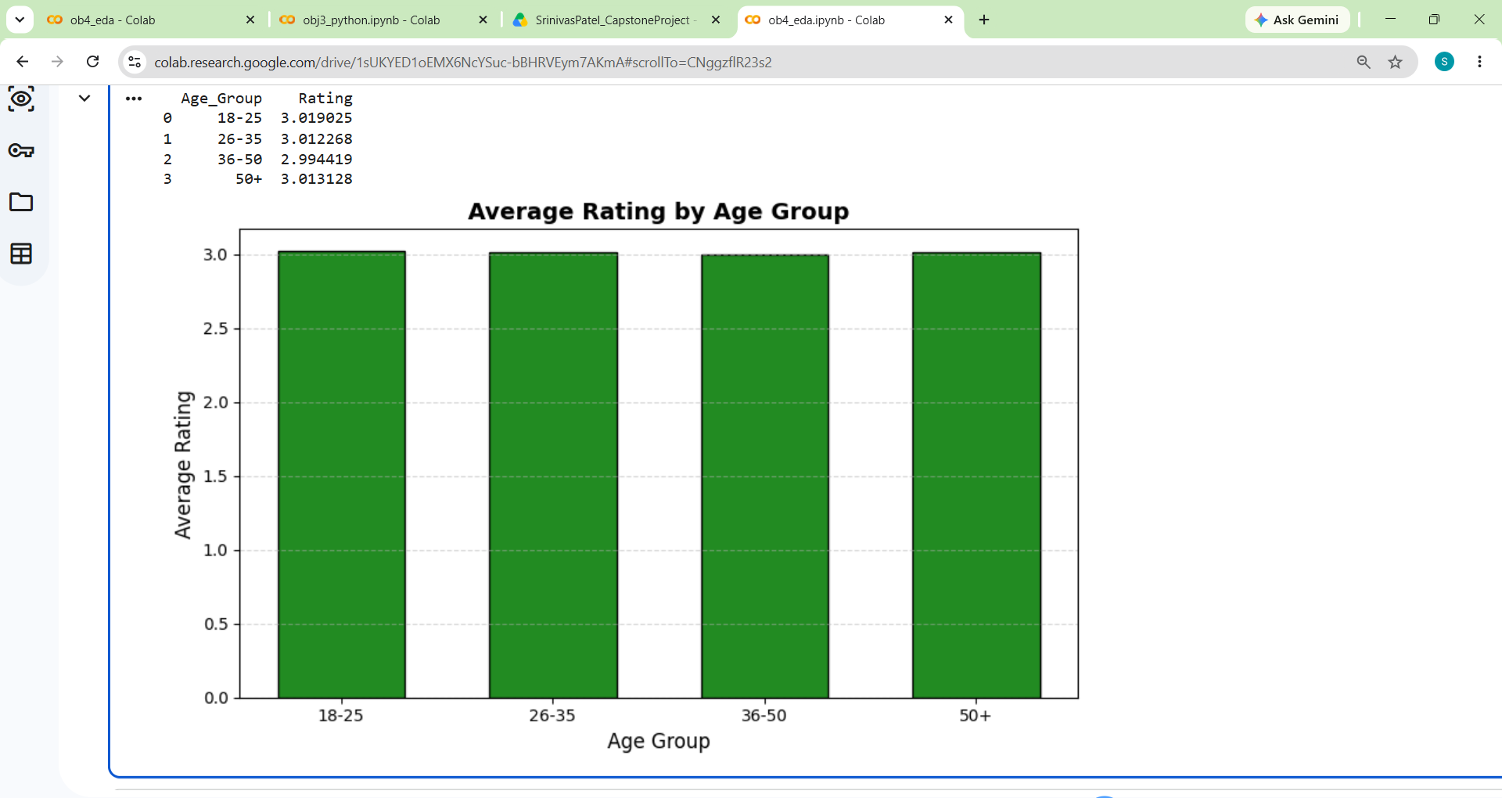
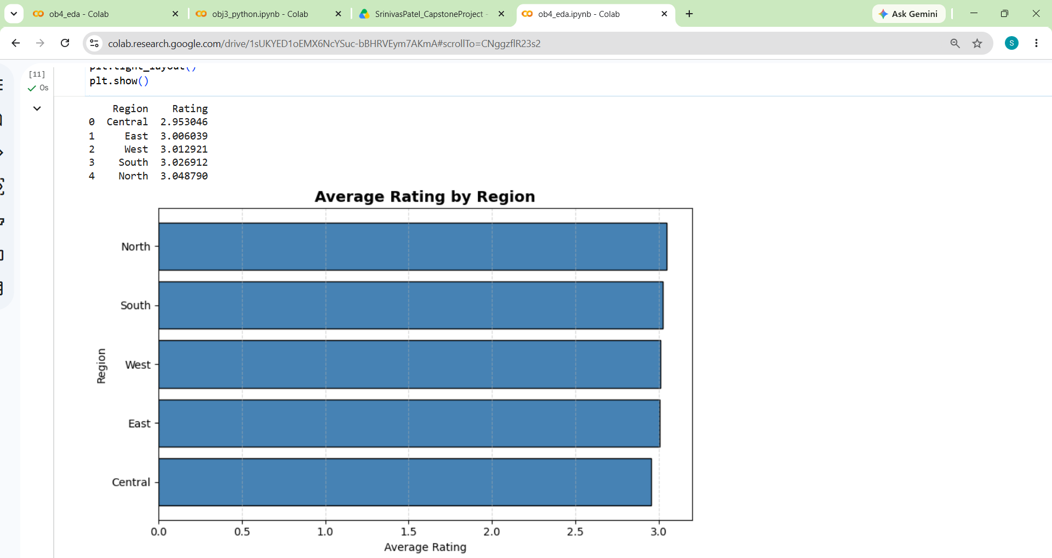
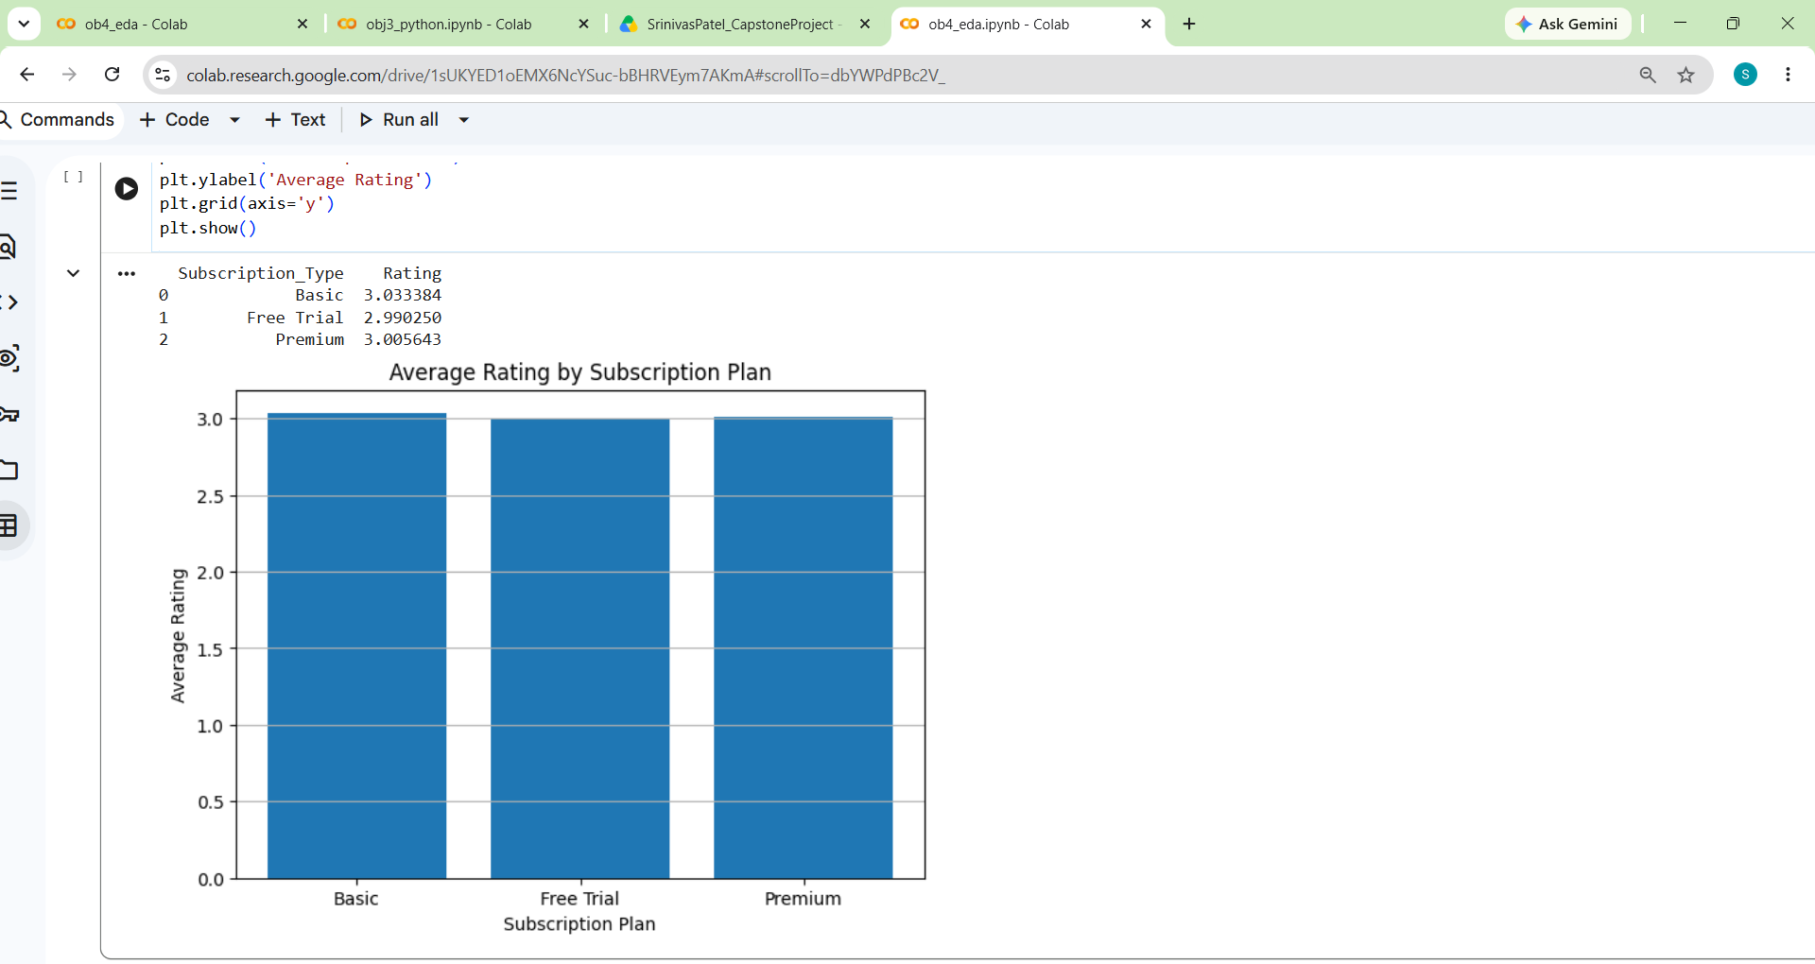
Task 1: Analyze User Ratings and Reviews
Q. Which age group gives the highest average rating?
Q. Which region has the highest average customer rating?
Q. Which subscription plan receives the highest average rating?
Interpretation :- The 18–25 age group has the highest average rating (3.02)
Interpretation :- The North region has the highest average rating (3.05)
Interpretation :- The Basic subscription plan has the highest average rating (3.03)

Slide 19
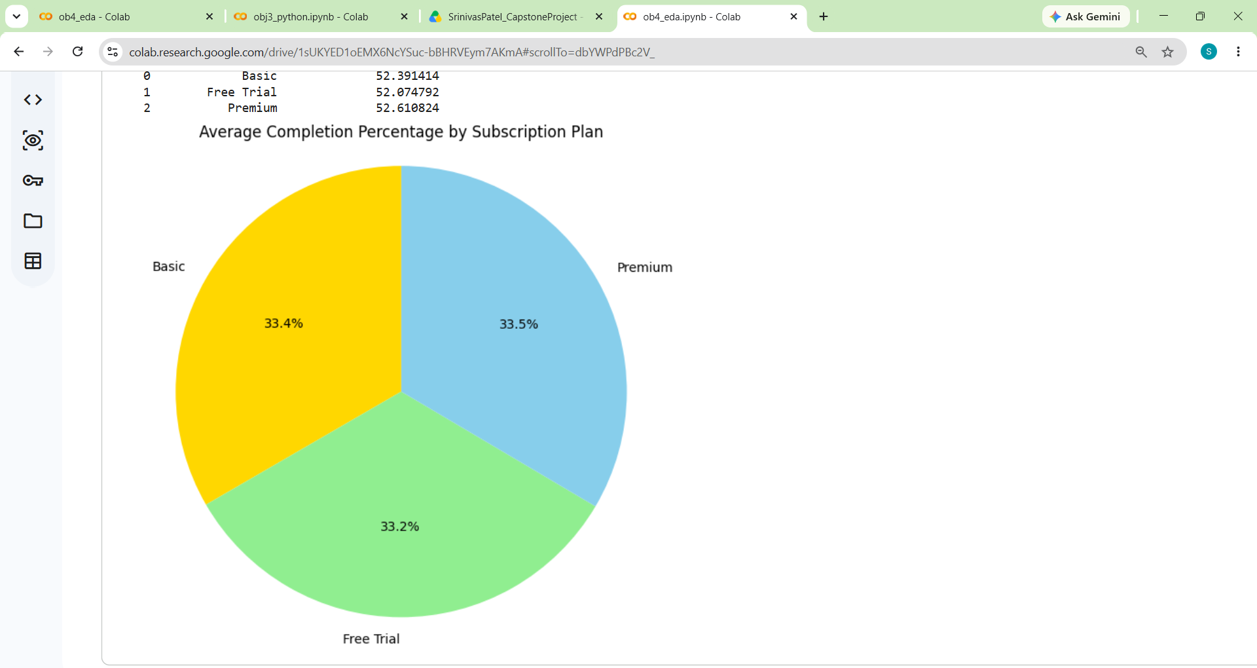
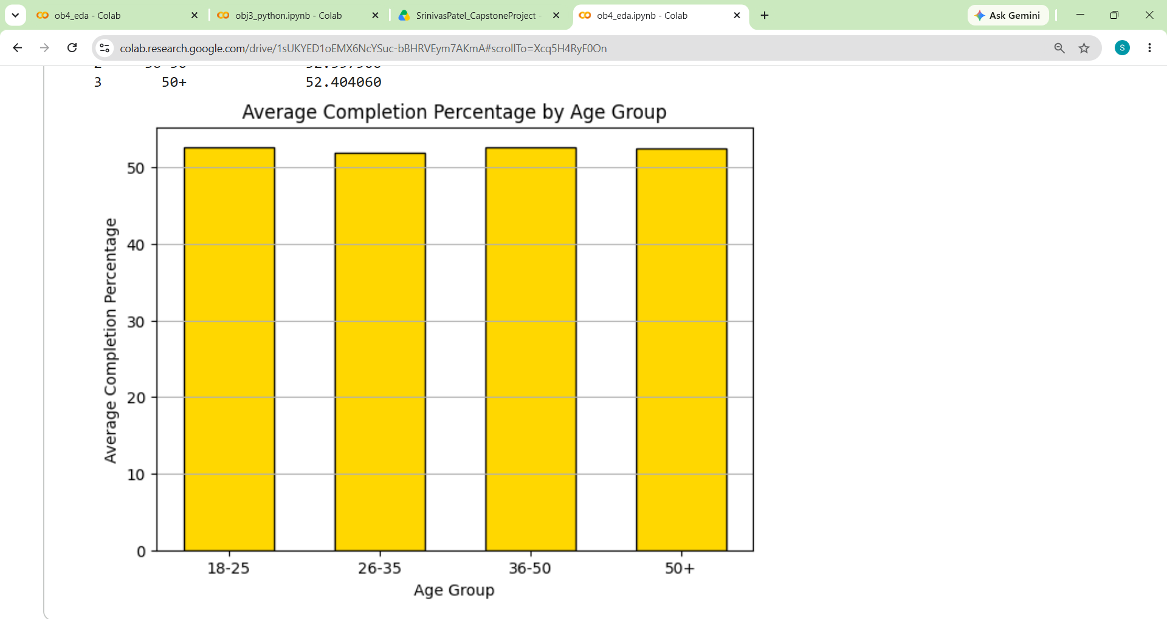
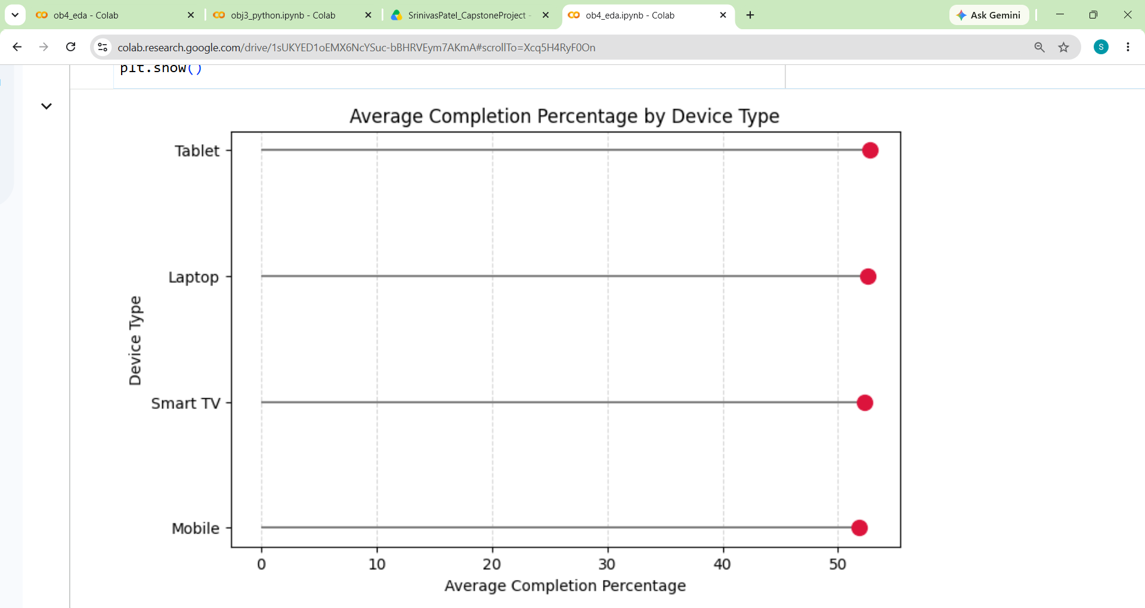
Task 2: Evaluate Content Completion Behaviour
Q. Which subscription plan has the highest average content completion percentage?
Q. Which age group has the highest average content completion percentage?
Q. Which device type has the highest average content completion percentage?
Interpretation :- The 18–25 age group provides the highest average rating of approximately 3.02.
Interpretation :- The 36–50 age group has the highest average completion percentage (52.60%),
Interpretation :- The Tablet device has the highest average completion percentage,

Slide 20
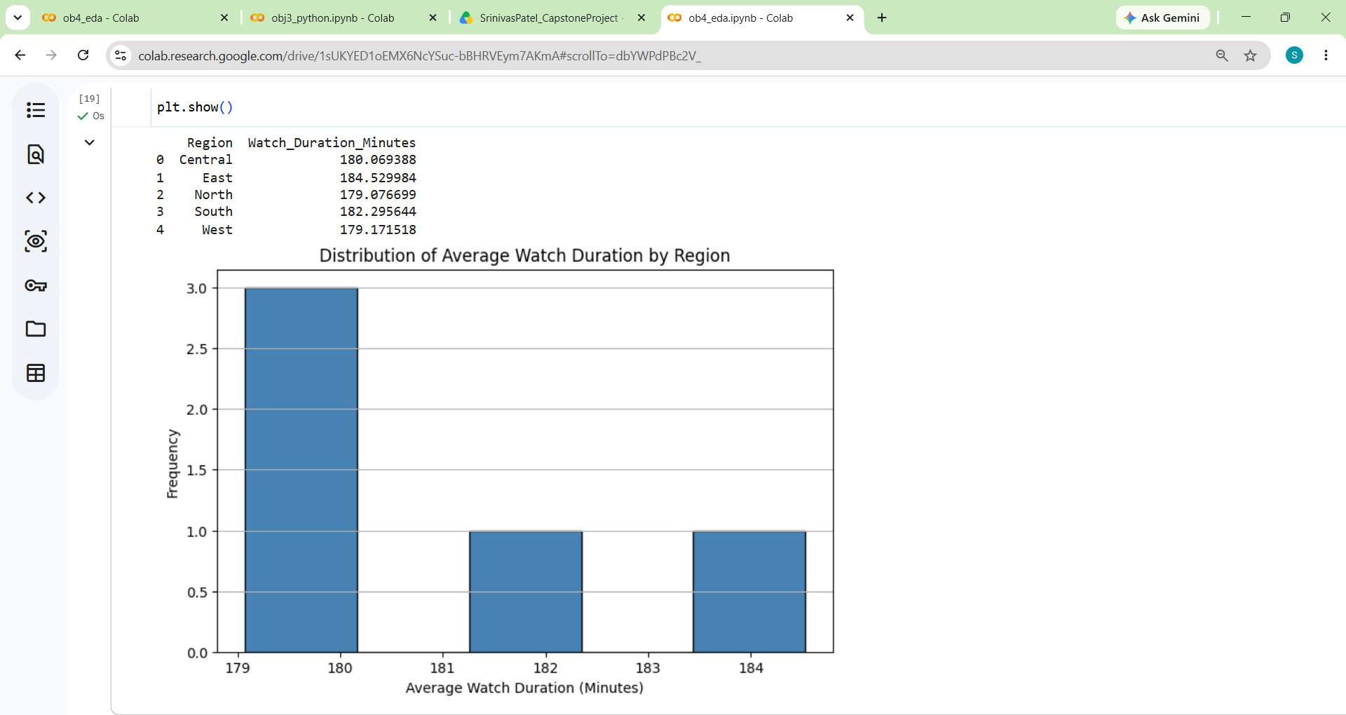
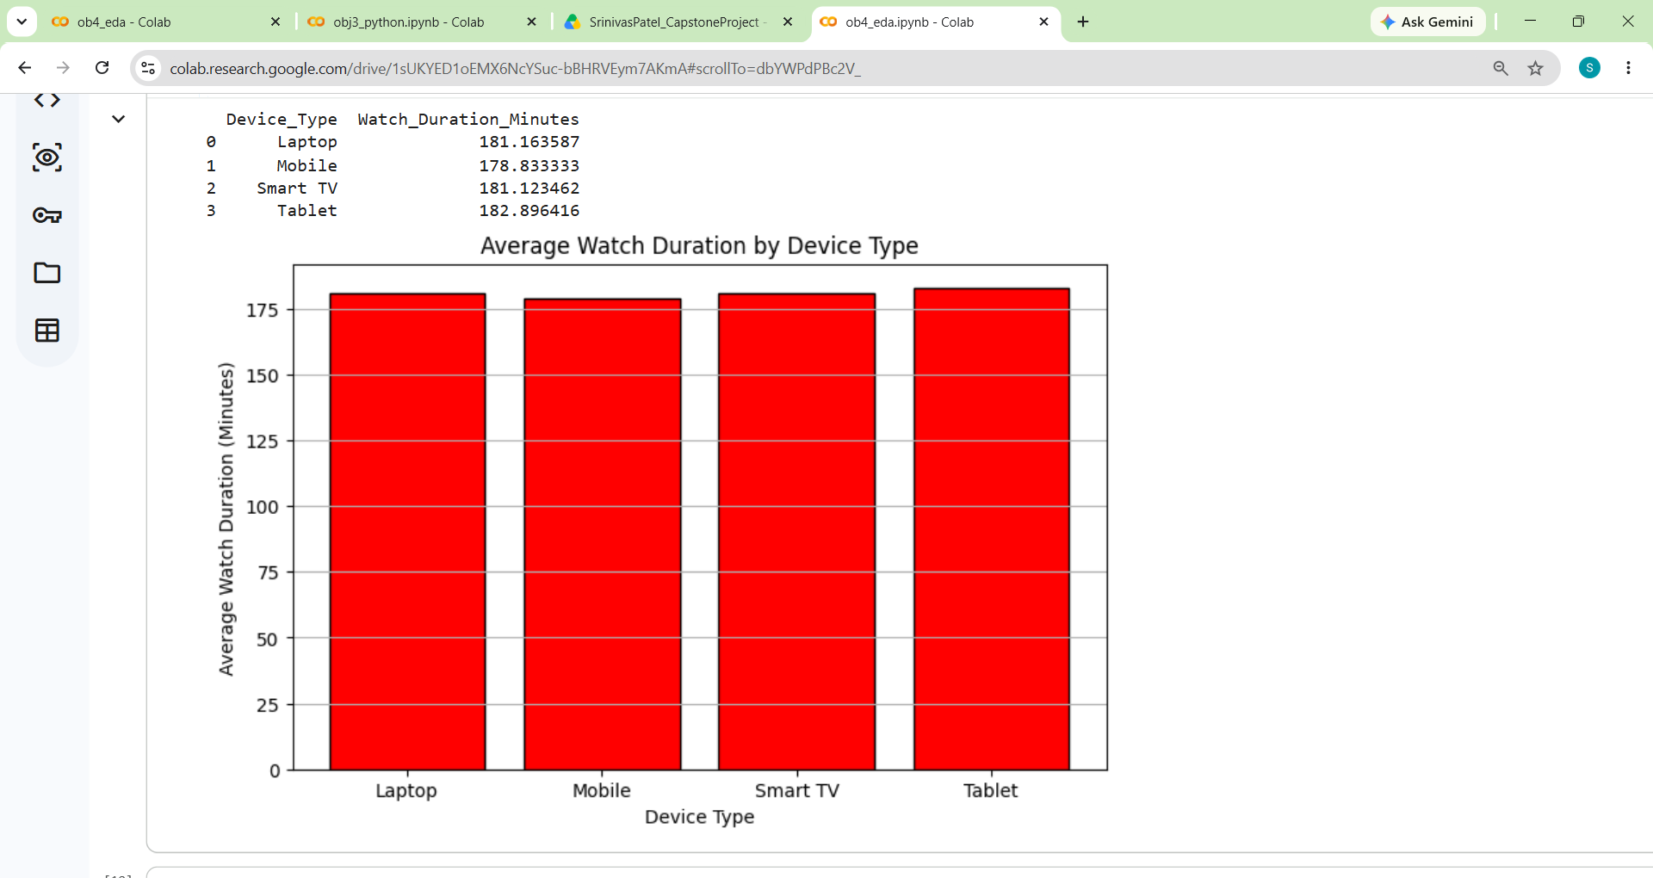
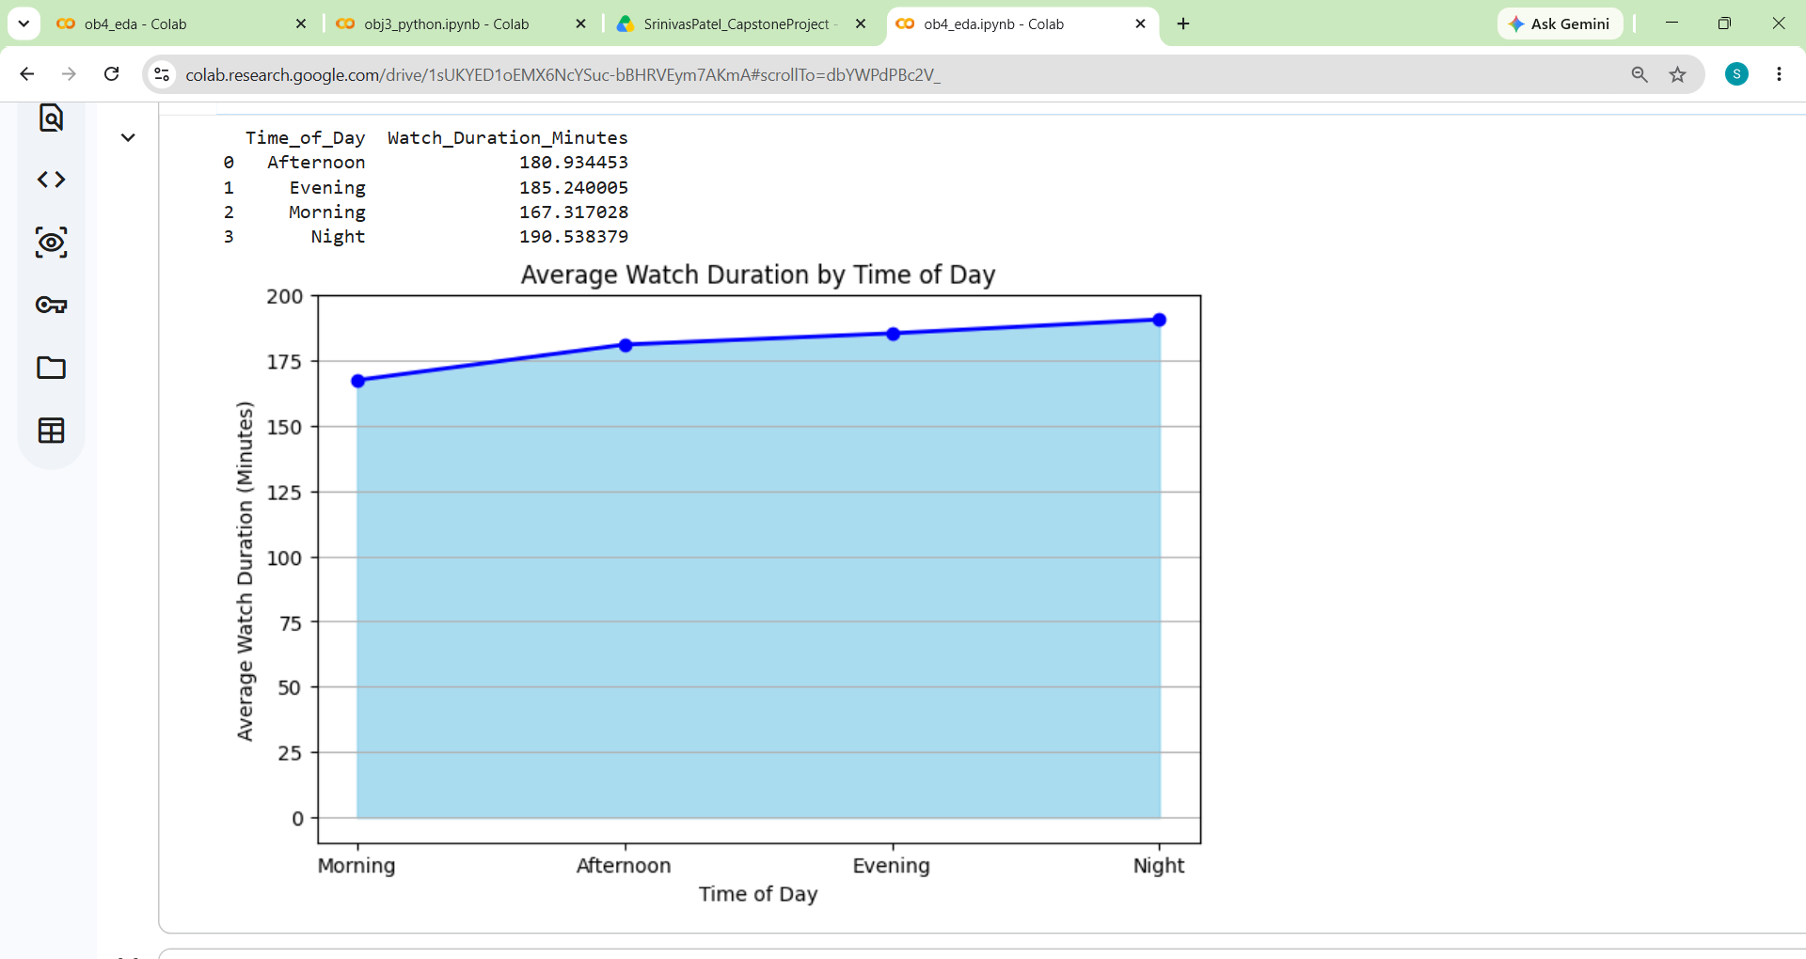
Task 3: Identify Overall Viewing Behaviour Patterns
Q. Which region has the highest average watch duration?
Q. Which device type has the highest average watch duration?
Q. Which time of day has the highest average watch duration?
Interpretation :- The East region has the highest average watch duration (184.53 min),
Interpretation :- The Tablet device has the highest average watch duration (182.90 minutes),
Interpretation :- The Night time period has the highest average watch duration (190.54 minutes),

Slide 21
Objective 5 :- Present Business Insights

Slide 22
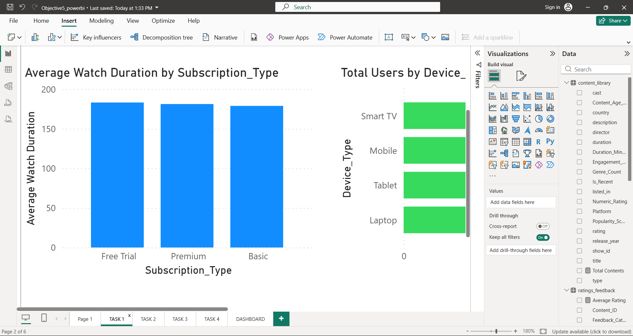
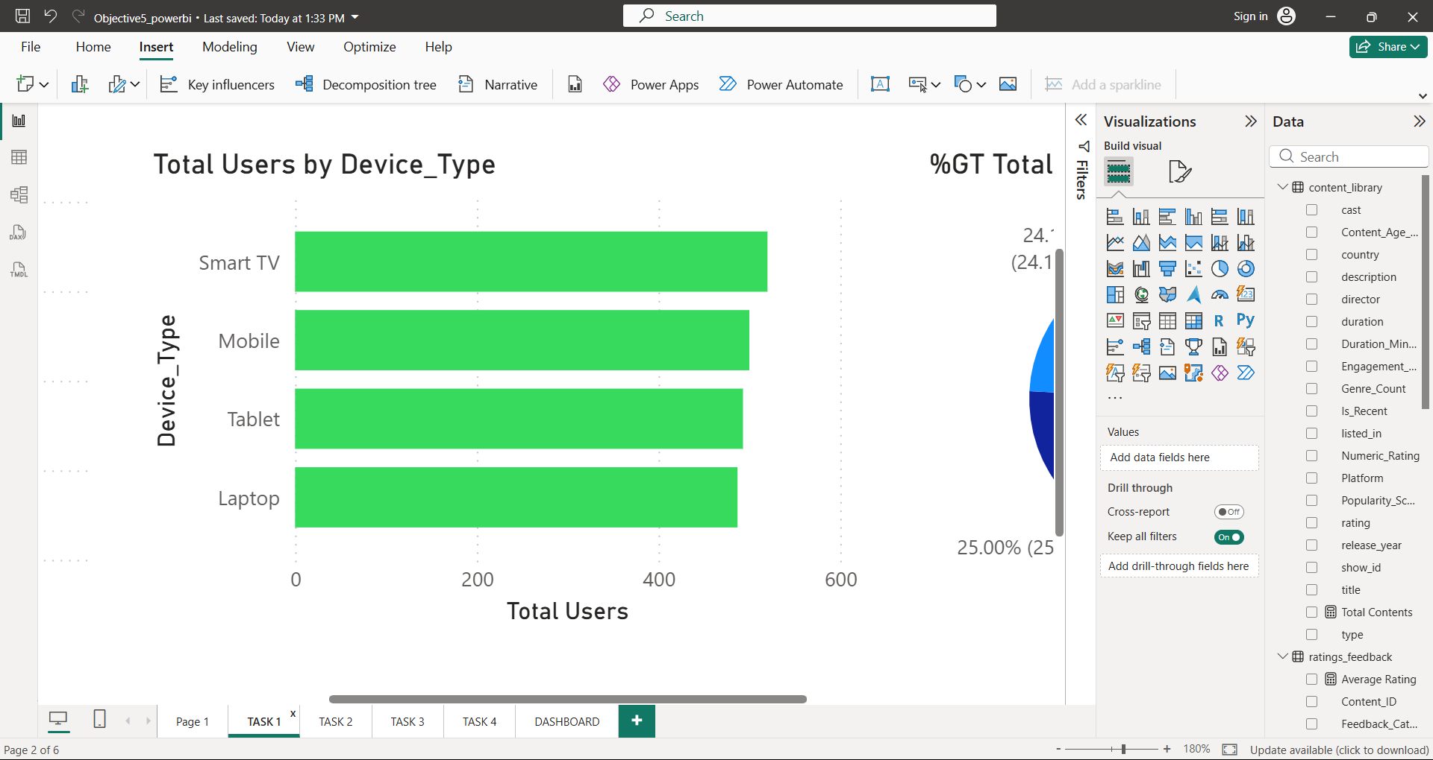
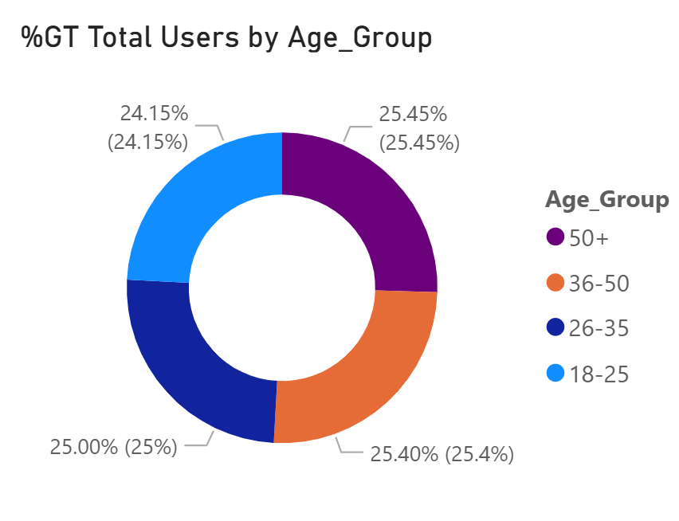
Task 1: Analyze User Engagement Insights
Q. Which subscription plan has the highest average watch duration?
Q. Which device type is most preferred by users?
Q. How are users distributed across different age groups?
Interpretation :- Free Trial users record the highest watch duration among all subscription plans.
Interpretation :- Smart TV is the most preferred streaming device among users.
Interpretation :- User distribution is nearly balanced across all age groups with 50+ age group being highest

Slide 23
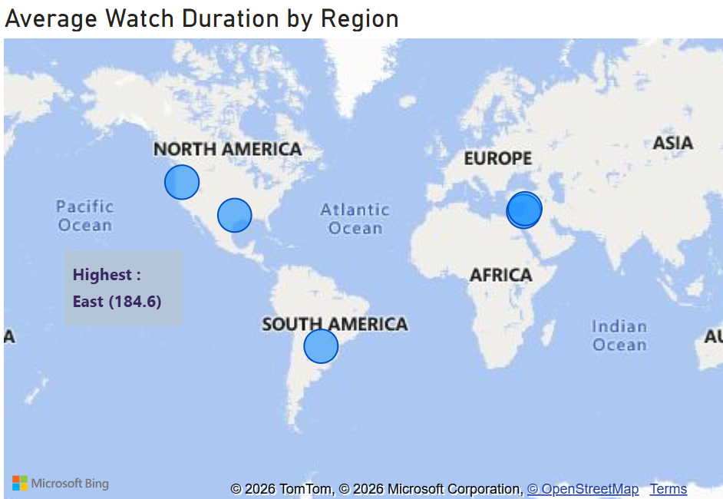
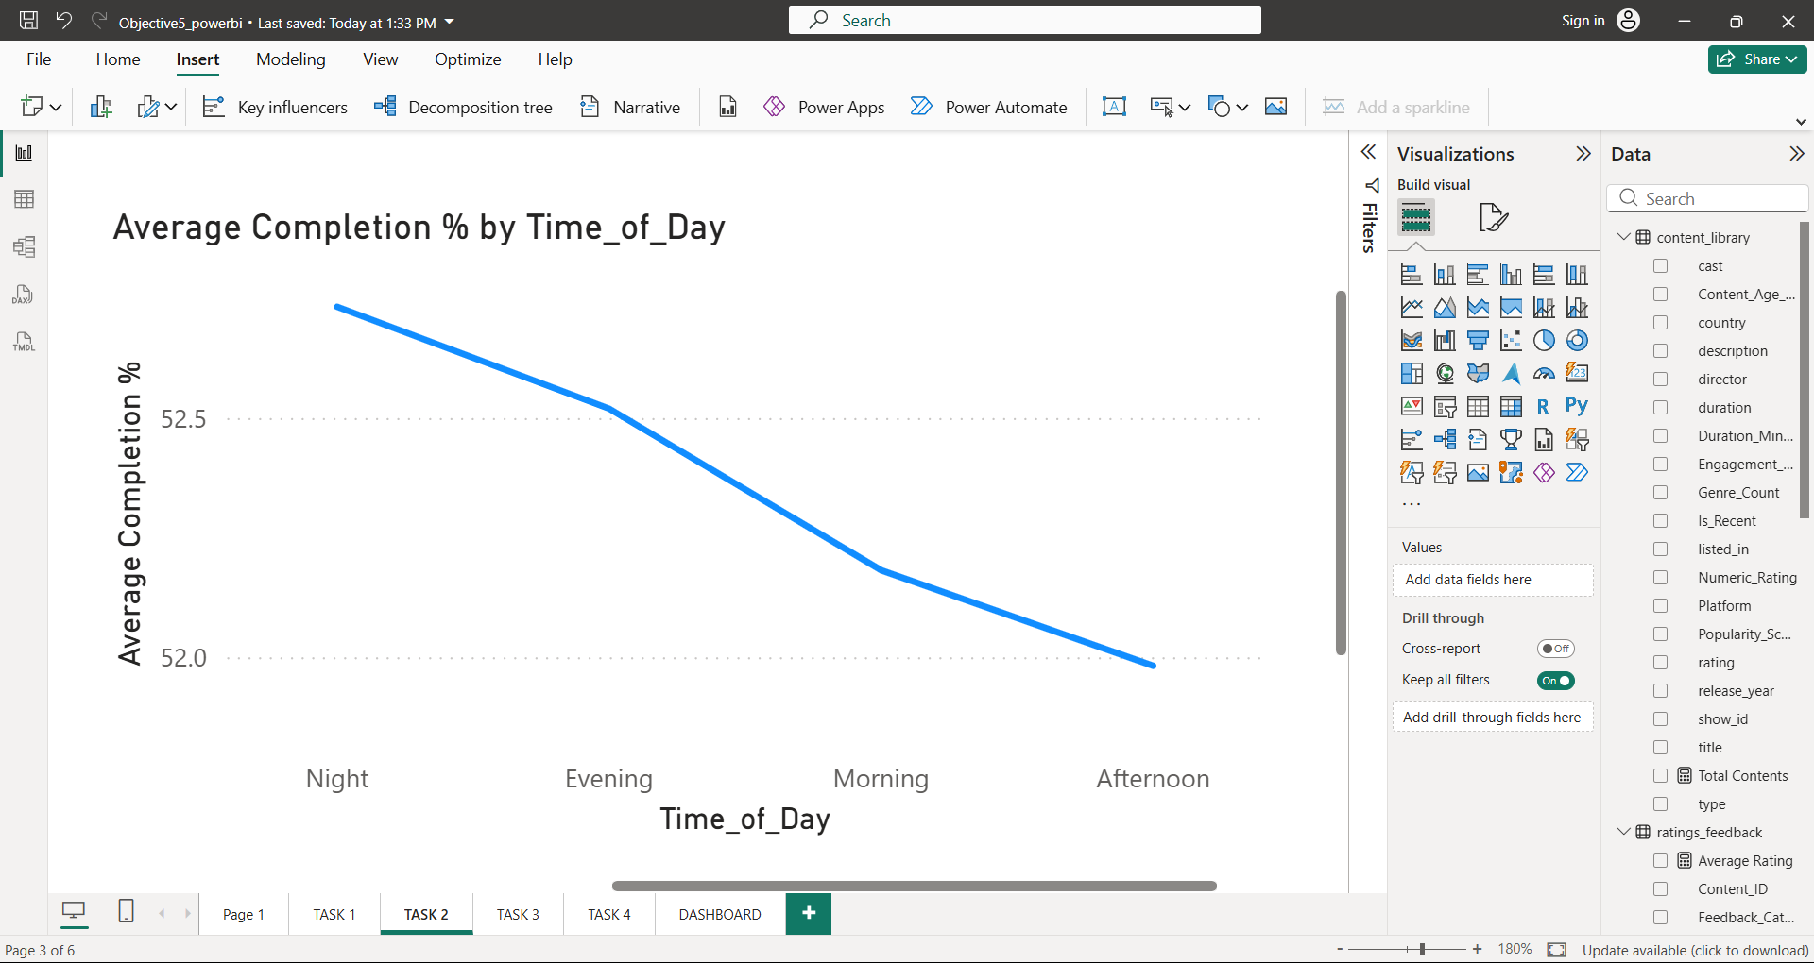
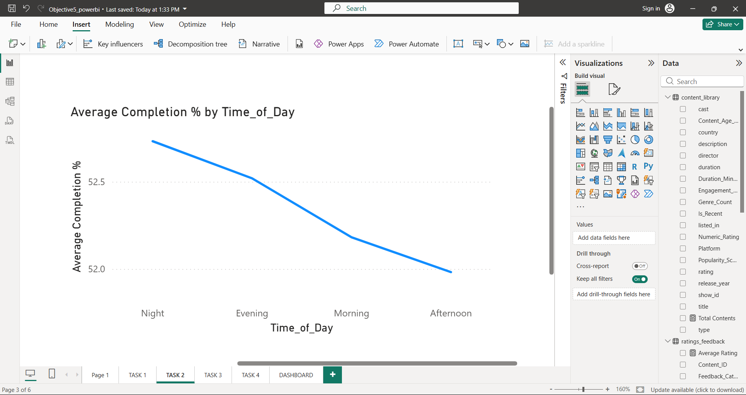
Task 2: Analyze Viewing Behavior
Q. Which region records the highest average watch duration?
Q. How does viewing completion trends vary across different times of the day?
Interpretation :- East region demonstrate highest average watch duration
Interpretation :- Average completion percentage is highest at night and gradually decreases during the day.

Slide 24
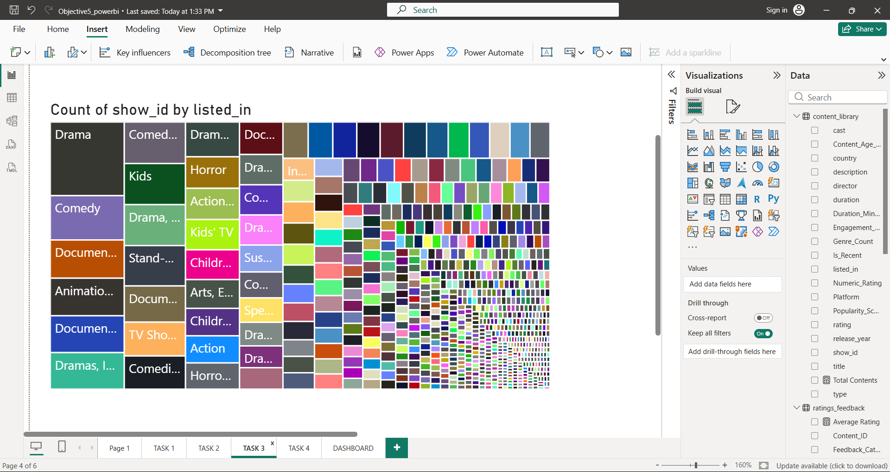
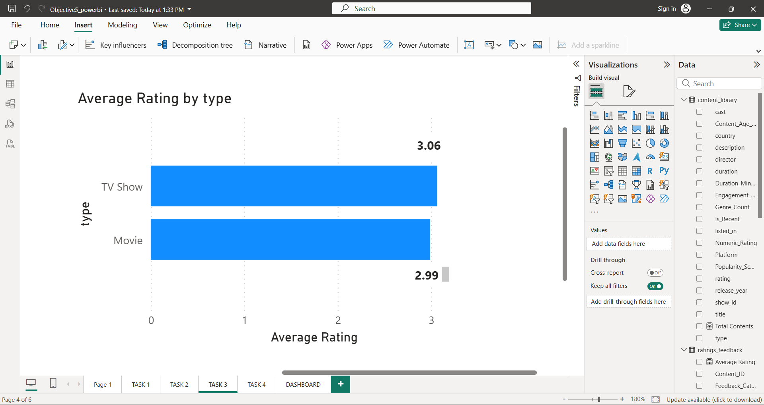
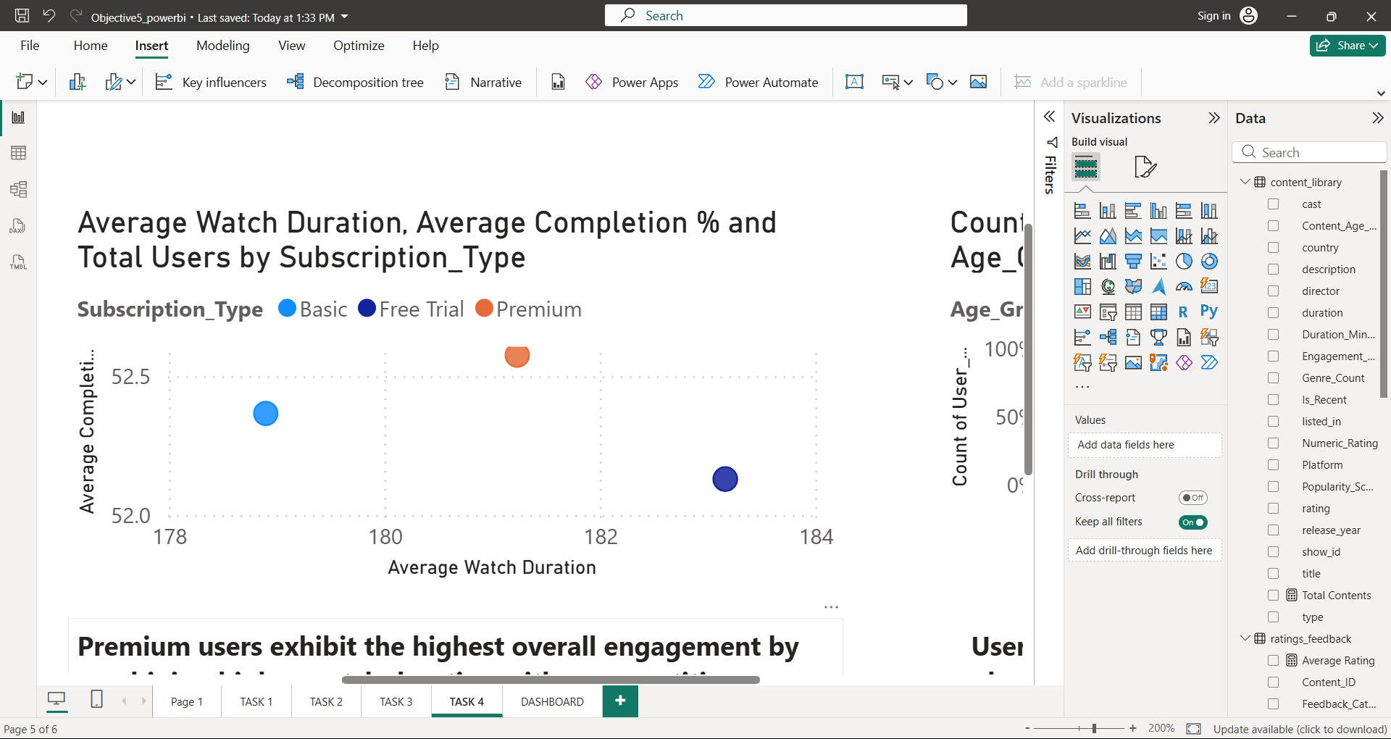
Task 3: Analyze Content Performance
Q. Which genre contains the highest number of content titles?
Q. Which content type receives the highest average user rating?
Q. Which subscription plan demonstrates the best overall user engagement?
Interpretation :- ‘Drama’ movies contributes the highest number of available contents
Interpretation :- TV Shows receives higher average user ratings (3.06) than Movies (2.99) in OTT
Interpretation :- Premium subscription users exhibit the strongest overall user engagement

Slide 25
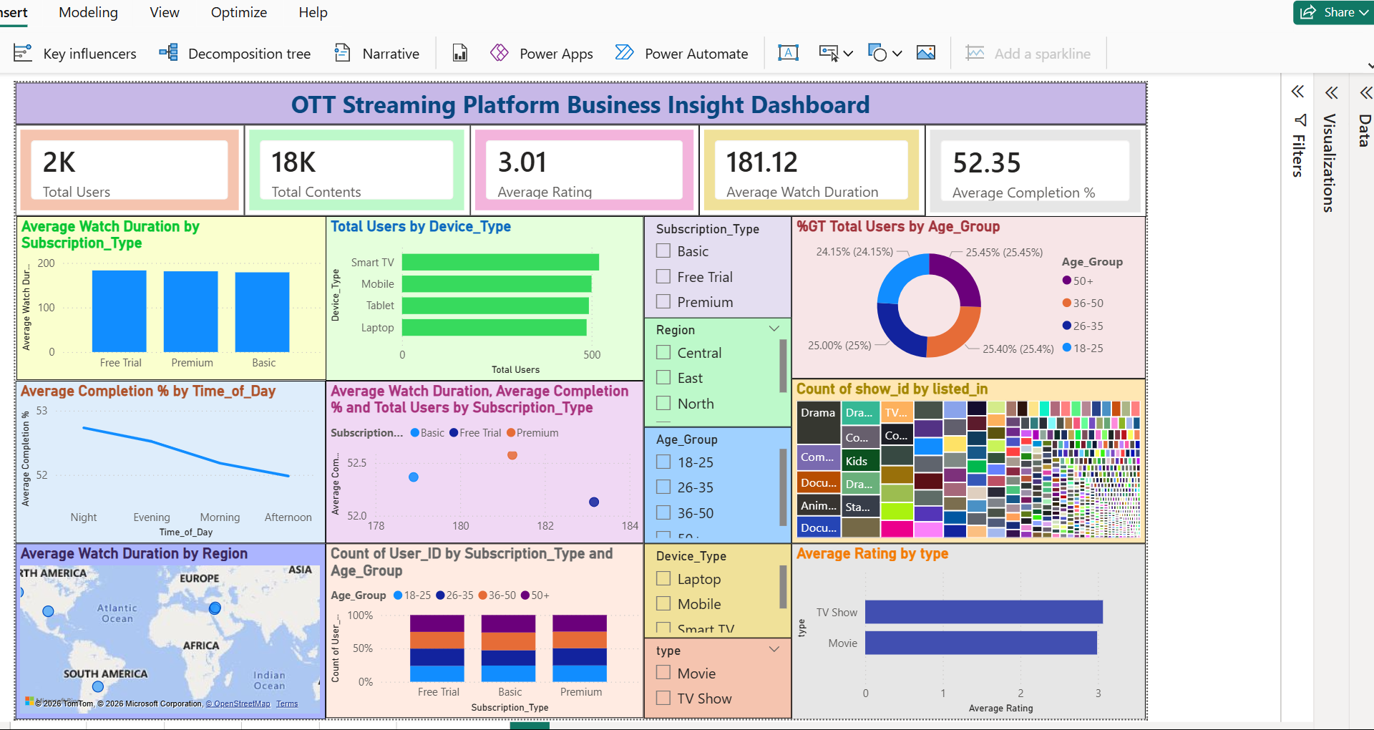
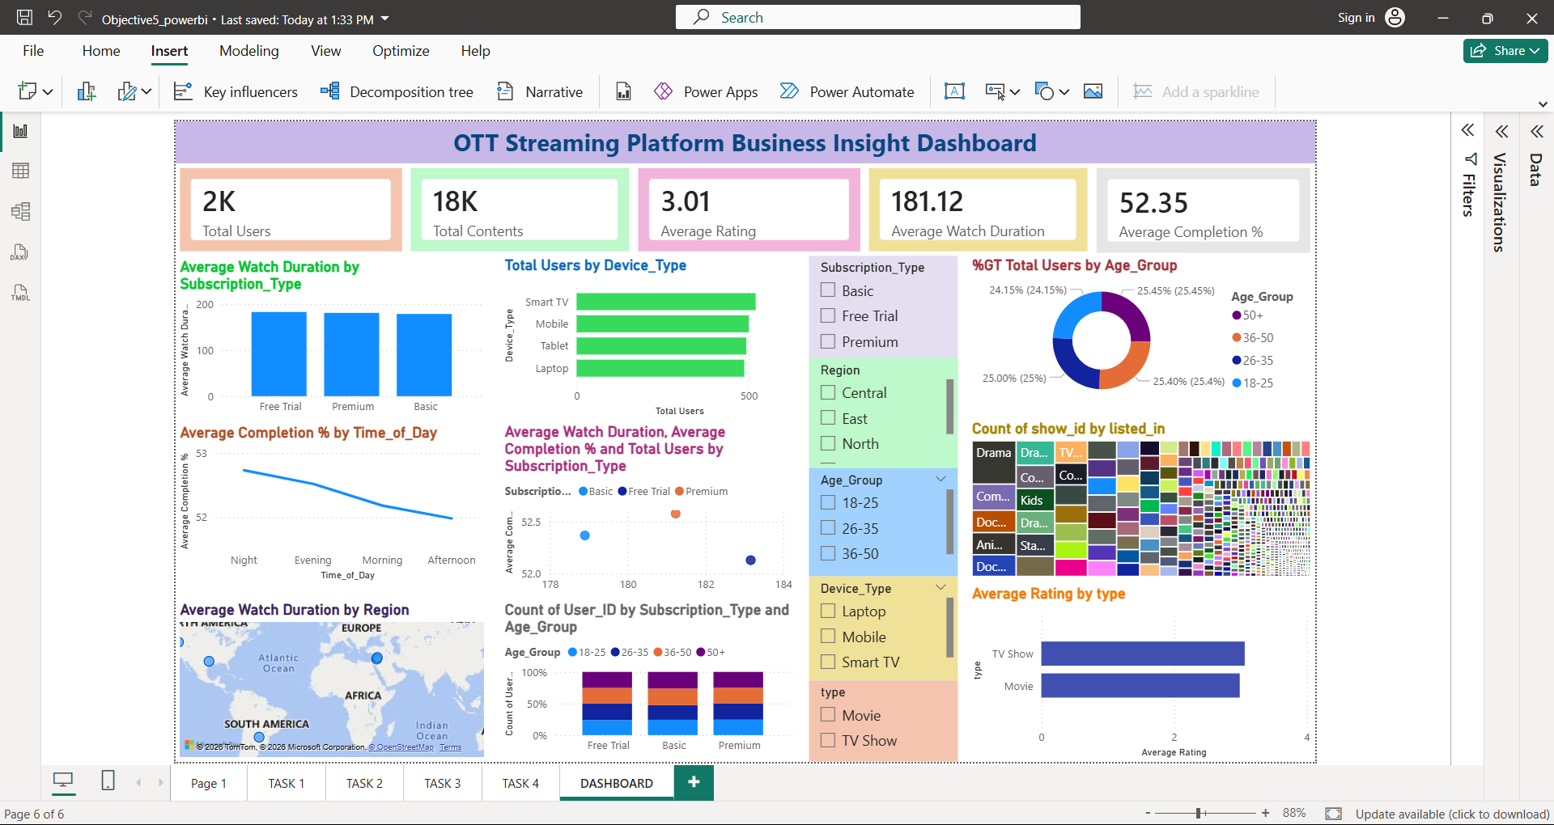
DASHBOARD

Slide 26
Objective 6 :- Support Business Decisions

Slide 27
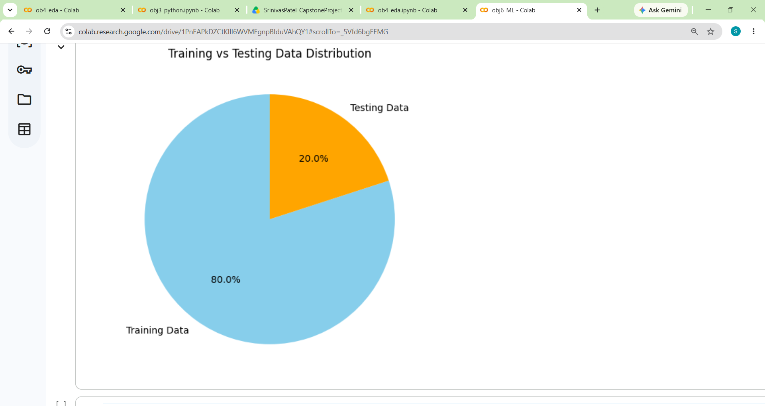
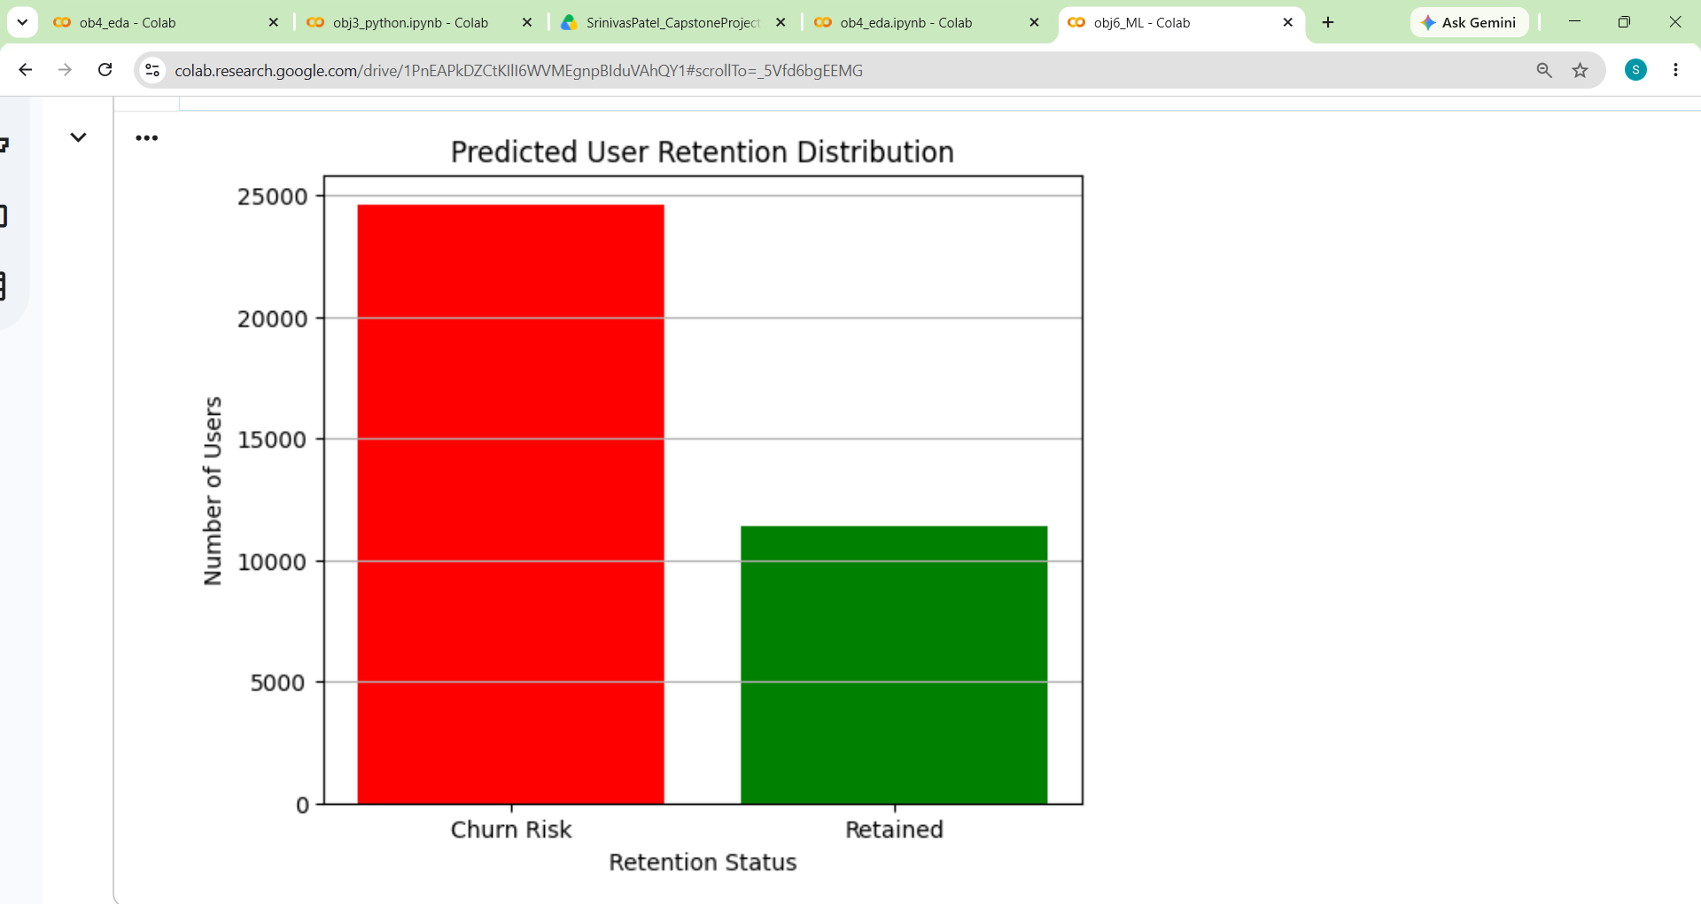

Task 1: Predict Future User Retention Trends
Q. How is the data divided for training and testing the prediction model?
Q. How many users are predicted to be retained and at churn risk?
Q. How closely do the predicted retention results match the actual outcomes?
Interpretation :- The dataset is split into 80% training and 20% testing for reliable model evaluation.
Interpretation :- The model predicts that more users are at churn risk than retained.
Interpretation :- The predicted results closely match the actual retention distribution, indicating good model performance.

Slide 28



Task 2: Identify Users with Churn Risk
Q. How many users are identified as being at churn risk?
Q. How are users distributed based on churn probability?
Interpretation :- Significant number of users (24618) are predicted to be at high churn risk.
Interpretation :- Most users have either very low or very high churn probability, enabling targeted business actions.

Slide 29


Task 3: Evaluate Prediction Results for Business Decisions
Q. Which genre contains the highest number of content titles?
Q. Is the prediction model accurate enough to support business decisions?
Interpretation :- The model classified 22,462 non-churn users and 9,708 churn users, out of which 1,674 non-churn users and 2,156 churn users were misclassified.
Interpretation :- The model achieved 89.36% accuracy, making it reliable for supporting business decisions.

Slide 30
SUMMARY
Collected OTT platform datasets from NIIT portal .
Analyzed user behaviour, viewing patterns, and subscriptions.
Compared engagement across age groups, regions, devices, and viewing time.
Identified popular content and user preferences.
Presented insights using interactive dashboards and reports.
Predicted user retention and identified churn-risk users.
Provided business recommendations to improve user experience and retention.

Slide 31
CONCLUSION
Successfully analyzed OTT platform data to understand user behaviour and viewing trends.
Identified key factors influencing content popularity, user engagement, and subscription retention.
Generated meaningful insights to support better content and customer retention strategies.
Predicted user retention and identified potential churn-risk users for proactive decision-making.
Developed interactive dashboards and visual reports for easy business analysis.
The project demonstrates how data-driven insights can improve business decisions and enhance the overall user experience.

Slide 32
THANK YOU

